Slide 1


Medication Reconciliation Rewards Pilot
Project References
Notes:
INTRODUCTION (WHO WE ARE):
ulaHealth is a health tech startup based in Austin, Texas that has engaged with the community care group to address issues related to medication reconciliation.
The emphasis or focal point will be with the local Medical Access Program (MAP) where a select patient population will navigate the inventory of their medications, through the use of a mobile app, to then track and share medication data with various physicians and/or clinicians.
A web based mobile responsive application will be tested in a limited beta pilot within the framework of a community clinic settings, Android and iOS apps will follow before end of year 2017 with the support of grant funds.

Slide 2
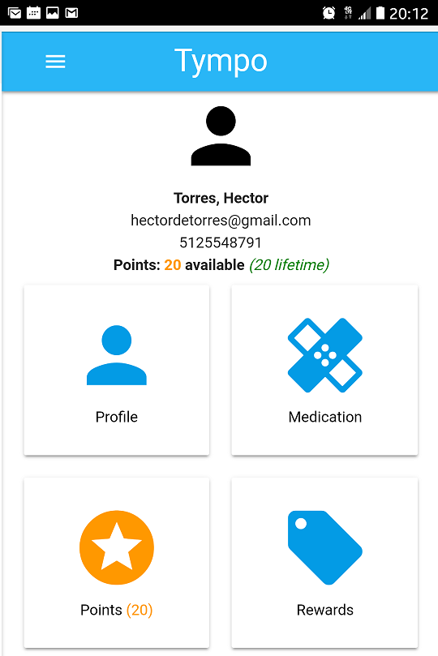
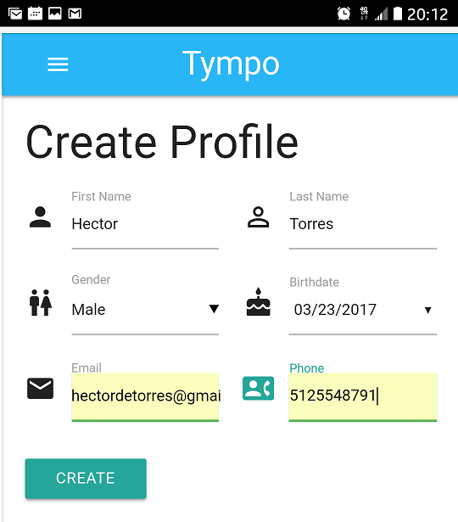
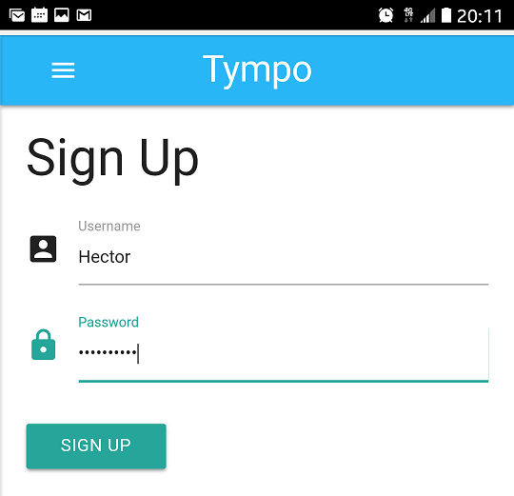
The Problem We Are Solving:
Medication Reconciliation
Notes:
WHAT WE ARE DOING
The focus of this project is simple, maintain a foundation that generates positive outcomes based on patient behavior change; we will achieve this aim by helping users manage their medication inventory using the Tympo app, which facilitates information collection and sharing between patients and physicians or clinicians.
The Tympo app allows patients to create an account/profile, upload their medication information and share that information with physicians/clinicians; healthcare navigators will assist patients with adding their medication(s), the system rewards patients, points are generated at time of activity, then patient redeem rewards for items such as real-time co-pay reimbursement, free or discounted fares with local ride sharing companies and more to come. The goal is to continuously engage the patient/user to generate more data that provide insights on how to better cater curated and relevant information.
SHORT TERM
The short term goal of the project is to affect patient behavior towards engagement and rewarding them based on continuous updates and management of their medication data inputs.
LONG TERM
The long term goal is to use blockchain as a foundation of a shared ledger and other mobile client centered applications. These would help manage the ledger of transactions and begin to reduce healthcare costs relative to a more cohesive, integrated and frictionless system that eases the burden on physicians and clinicians with sharing a comprehensive list of patient medication data across healthcare settings in a secure and most cases anonymous method where necessary.

Slide 3



Healthcare is in a Crisis
$10,345/person
Number crunchers from Department of Health & Human Services project health care spend will grow at faster rate than the national economy over the coming decade.
That squeezes the ability of federal, state, local governments, employers and average citizens, to pay.
$10,345/person
$10,345/person
$10,345/person
Healthcare spend at an all time high in U.S.
Sources: the-u-s-spends-more-on-health-care-than-any-other-country-heres-what-were-buying/ http://tinyurl.com/m4xj8nj
$10,345 per person: U.S. health care spending reaches new peak http://tinyurl.com/hjga4wh
Notes:
WHY WE ARE DOING THIS (OUR PASSION = improving healthcare)
The big picture or why we have chosen to take this path is clear; Healthcare costs are increasing year over year; presently on average Americans pay approximately $10,345 per person for healthcare service delivery. ulaHealth seeks to assist patients in managing their medications and rewarding them for their activities using our mobile app; we aim to incrementally reduce healthcare costs, improve the user experience and slowly we’ll begin to move the needle towards improving population health.
Some stats:
Total health expenditure hit $3.35 trillion in 2016
Growth of healthcare spend is projected to average 5.8% from 2015 to 2025
Health care spending is wildly uneven; 5% of the population – the most frail of ill - accounts for nearly 50% of spending in a given year
From a personal perspective I am working towards tackling these problems for the uninsured, underinsured, the indigent population, the most ill, frail and vulnerable that in most cases cannot care for themselves and to some extent I’m referring to some of my family members.
PERSONAL PASSION
My mother, for example, is a two time stroke survivor and we almost lost her a few years ago; one of her many physicians prescribed her meds that would help her manage or regulate her blood coagulation better, she was taking blood thinners…and one day those medications interacted negatively to the point that her blood became too thin and she began to suffer internal bleeding, she was rushed to the hospital, luckily they were able to stabilize her and all turned out well.
The point of this is that had her physician been aware of all the medications she was taking, they probably would not have provided her additional medications that would have interacted with what she was already taking and a simple inventory check (medication reconciliation) could have prevented her episode and we could have mitigated these costs.
It is my hope that the initiatives outlined here will pave the way towards a new paradigm and shift existing inefficiencies in healthcare; I want to help other families avoid the stress, chaos and costs that can be avoided.

Slide 4
Pilot Project: Medication Reconciliation, RewardsNetwork + SmartRewards (Blockchain)
Patient Engagement
RewardsNetwork
SmartRewards
Medication Reconciliation
Patient Incentives
Blockchain
Behavior Change / Enhancements
Removes friction
Source of Truth
Notes:
HOW WE ARE DOING THIS
This project seeks to engage healthcare consumers to be active with updating and sharing their medication information. Medication reconciliation is the process of creating the most accurate list possible of all medications a patient is consuming – including drug name, dosage, frequency, etc – and comparing that list against the physician’s admission, transfer and/or discharge orders, with the goal of providing correct medications.
The first phase of this pilot seeks to assist patients with creating a profile in their app, entering the details of the medications they are currently on, uploading photos of the medications, sharing this information with physicians/clinicians and rewarding them [patient incentives] based on managing that information on an ongoing basis.
The second phase of the project will focus on implementing a blockchain solution that more efficiently and securely tracks and manages the point rewards system relative to specific tangible redemption products and services.

Slide 5

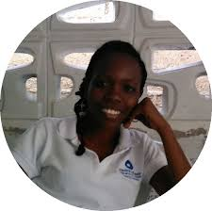


A Healthcare Ecosystem
& RoadMap:
Community Clinic
Regional Clinic
Retail Clinic
Community Health
Navigators
Radiology
Lab
Patient
Community Health
Navigatores
Payer (s)
Clinical Trials/
PCP
Hospital
Notes:
Creating an Eco System that does not exist
It is important to note that current information technology used by the healthcare systems do not capture all data that is continuously generated from multiple sources outside the traditional healthcare setting.
Social determinants of health generate multiple data sets that live outside the traditional healthcare setting and have a direct impact on the patient, relative to the health and well being of a patient, positive or negative; we seek to become a clearinghouse of new patient data that is being generated but not managed appropriately or effectively. These all can and do have a direct impact on the delivery and quality of healthcare.
Community healthcare navigator delivery teams will be trained to ensure proper user adoption success of this mobile health app and pilot. This diagram shows how technology, such as blockchain, can bring together typically disparate organizations and systems with community health navigators at the core. Together we can capture more data to help physicians, clinicians, friends and family members better care of their patients or loved ones.

Slide 6
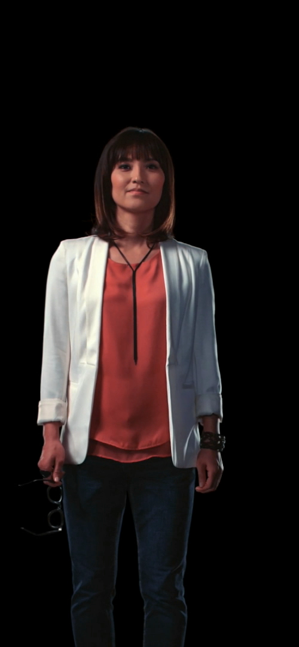
A vast amount of untapped data could have a great impact on our health — yet it exists outside medical systems
1100 Terabytes
Generated per lifetime
60%
Exogenous Factors
Volume, Variety, Velocity, Veracity
6 Terabytes
Per lifetime
30%
Genomics Factors
0.4 Terabytes
Per lifetime
10%
Clinical Factors
SOURCE: “Health Policy Brief: The Relative Contribution of Multiple Determinants to Health Outcomes,” Health Affairs, August 21, 2014.
Notes:
Additionally, relative to the data generation from multiple sources (outside the traditional healthcare setting(s)), we feel that we are playing an integral role in establishing ourselves as an information clearinghouse and a conduit for others to “plug” into the traditionally closed systems.

Slide 7
The Team
Hector Torres has been the chief orchestrator for the company and projects, collaborating and bringing together various communities is his passion as is being a healthcare innovator and disruptor.
He created the first Blockchain + Healthcare Innovation Summit that brought together IBM, UT Dell Medical School, Clinical Pathology Laboratories, Austin Regional Clinic, Law Office of Husch Blackwell and McGinnis Lochridge to discuss the opportunities in healthcare and how we might leverage emerging technologies such as blockchain. The event was hosted at GoogleFiber October of 2016, click the following link to get more details: ulaHealth Blockchain + Healthcare Summit
While serving as the Chief Technology Officer of an Austin based Latino Healthcare non-profit, he created and pioneered the first minority focused healthcare hack-a-thon named, cultivateHealthATX that IBM hosted October of 2015 which brought together UT Dell Medical School, Clinical Pathology Laboratories, City of Austin, St David’s RowdMap and others to assist teams with their innovation and development to tackle some of healthcare’s most pressing needs. The event centered around a community health assessment that was funded by the City of Austin.
Click here to see some event photos:
https://www.instagram.com/cultivatehealthatx/
Or click below to see a web site version:
http://ulahealth.me/cultivateHealthATX/
Hector Torres
CEO + Co-Founder
Notes:
Our team of experienced and involved individuals each brings a unique skill and perspective to this effort. Our composite efforts will bring about a practical and useful tool for this initial pilot effort of design, development an pilot test for further development and refinement prior to going live with the application itself.

Slide 8
The Team
Dan loves writing, testing, debugging and improving software, and is always looking for challenges, especially in the world of big data. He has worked in the kernel and user space. Dan excelled at eliminating performance bottlenecks and refactoring.
Dan wrote and hosted a web show on engineering.com called "This Week In Engineering," dedicated to everyone in the noble profession of building stuff.
Specialties: Refactoring, performance profiling and optimization, project management, linux, programming languages, competitive programming.
Dan Hedges
Co-Founder
Notes:
Our team of experienced and involved individuals each brings a unique skill and perspective to this effort. Our composite efforts will bring about a practical and useful tool for this initial pilot effort of design, development an pilot test for further development and refinement prior to going live with the application itself.

Slide 9
The Team
Salvador “Sal” Valdez is an experienced public, private and not-for-profit sector Executive Management professional. Sal has consulted both as a business and marketing development professional as well as community and economic development across the State.
His Texas Legislative experience includes serving as the Chief of Staff and Legislative Director for the former Dean of the Texas Senate Carlos Truan. He also served as the Senior Legislative Analyst for the Senate Committee of the Whole for redistricting, Director of the Senate Committees of: International Relations Trade and Technology, Senate Committee for Military Installations and Veterans Affairs and the Senate NAFTA Committee.
Mr. Valdez has served in numerous appointed and volunteer capacities. He has provided both support and leadership vision in addressing community issues of juvenile justice, homelessness, hunger and health disparities as well as community and economic development policy and strategies specific to the small and minority business sectors.
Sal Valdez
Chief Operations Officer
Notes:
Our team of experienced and involved individuals each brings a unique skill and perspective to this effort. Our composite efforts will bring about a practical and useful tool for this initial pilot effort of design, development an pilot test for further development and refinement prior to going live with the application itself.

Slide 10
The Team
Dr. Ray Atilano played an integral role with orchestrating the ulaHealth Blockchain + Healthcare Innovation Summit and served as a moderator for the Austin Regional Clinic information question and answer session.
Prior to his ulaHealth roles, the NeuroTexas Institute Research Foundation named Ray Atilano, Ph.D., as its executive director, in March of 2015. In this role, Atilano will oversee business development for the foundation, as well as establish growth plans and fundraising strategies. The NeuroTexas Institute Research Foundation conducts advanced clinical, translational and computational neuroscience research to increase access to advanced medical therapies and surgical protocols, as well as innovative technology, for patients.
"Given the depth of his experience, we are confident that he will play a key role in the growth of the NeuroTexas Institute Research Foundation," Philippe Bochaton, president of the NeuroTexas Institute Research Foundation and chief administrative officer of NeuroTexas Institute, said. "Ray has a proven track record of developing research collaborations and outreach activities, which will ultimately benefit our patients in the form of advanced and innovative neurological research.“
Prior to joining the NeuroTexas Institute Research Foundation, Atilano served as the executive director of Technology Commercialization and Knowledge Transfer at The Ohio State University in Columbus, Ohio. He also worked in the Office of Technology Commercialization at The University of Texas at Austin, where he led the evaluation of commercial opportunities of medical devices/life science research development, fundraising, research collaborations with physicians, marketing and the negotiation of licenses.
Dr Ray Atilano
Chief Medical Officer
Notes:
Our team of experienced and involved individuals each brings a unique skill and perspective to this effort. Our composite efforts will bring about a practical and useful tool for this initial pilot effort of design, development an pilot test for further development and refinement prior to going live with the application itself.

Slide 11
The Ask, What we would do with the money?
ulaHealth seeks support for the following key initiatives/milestones:
UI / UX
Development
Ongoing
Security / HIPAA Compliance
Ongoing
Blockchain
Development
Ongoing
Android / iOS
Development
Ongoing
Health Navigators
Engagement / Training
Pay-it-forward
Community
Development/Re-investment
Notes:
WHAT WE WILL DO WITH THE FUNDS
UI / UX Development ongoing costs
Security / HIPAA Compliance ongoing costs
Blockchain development ongoing costs
Android / iOS development
Health navigators train the trainers; incorporating local tech savvvy community members to engage in this project and its development is key, we feel, towards ensuring successful user adoption
We are working to bring new technology to the table with the support of average citizens of a community together to make healthcare more accessible and easier to navigate for everyone’s benefit. We aim to reinvest in the communities we serve.

