Slide 1
MPV – 701
External Agency Orientation
Austin – Travis County EMS
Emergency Management Division
Chief Elliott
Commander Noble

Slide 2
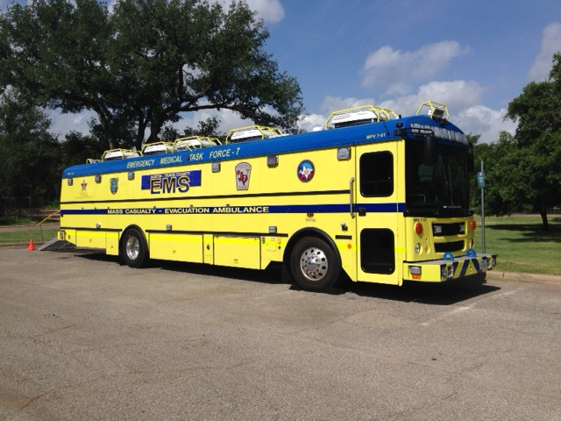
Outline
Background of Ambus Program
Overview of Ambus Operations

Slide 3
Overview of Ambus Program
Purchased in 2012
State Homeland Security Program Grant
  Approx. $500,000
  Owned by City of Austin
  Partnership between CAPCOG, CATRAC, EMTF, and ATCEMS

Slide 4
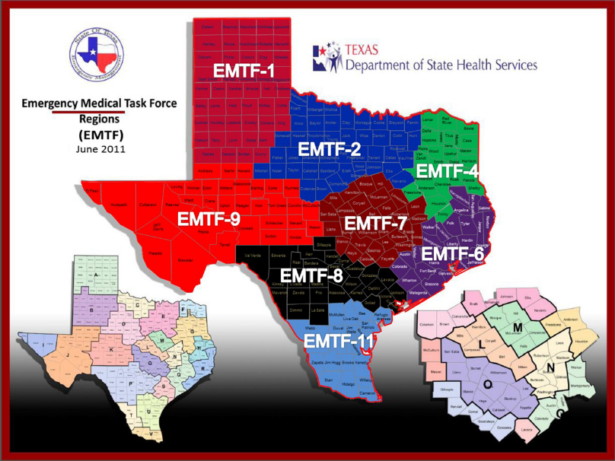
Overview of Ambus Program
Texas Emergency Medical Task Force Program
  EMTF 7
    8 EMTF Regions in state
  Each EMTF is tasked with the following:
    1 MMU
    5 RN Strike Teams
    5 Ambulance Strike Teams
    2 AmBuses (13 Current)

Slide 5
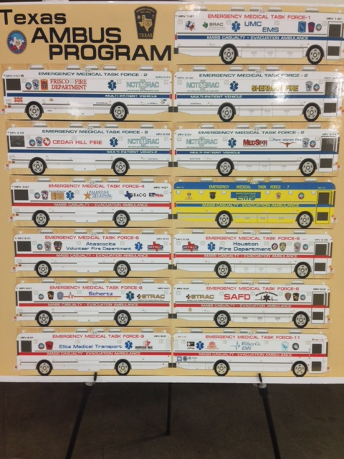
Overview of Ambus Program
EMTF 1
  UMC (Lubbock) EMS (MPV-101)
EMTF 2
  Frisco FD (MPV-201)
  Sherman FD (MPV-202)
  Cedar Hill FD (MPV-203)
  MedStar (MPV-204)
EMTF 4
  Palestine EMS (MPV-401)
EMTF 6
  Atascocita FD (MPV-601)
  Houston FD (MPV-602)
EMTF 7
  Austin Travis County EMS (MPV-701)
EMTF 8
  Schertz EMS (MPV-801)
  San Antonio FD (MPV-802)
EMFT 9
  Elite Medical Transport (MPV-901)
EMTF 11
  Willacy County EMS (MPV-1101)

Slide 6
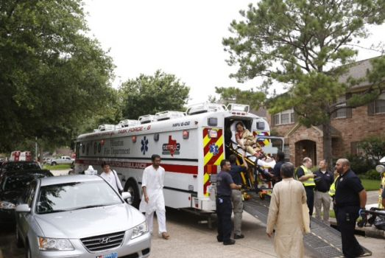
Overview of Ambus Program
Missions of AmBus
  Evacuations
    Nursing homes
    Hospitals
  MCI
    Local, regional, state
  Rehab / Command Post / Medical Aid Station
    Local, regional, state
  Orientations / Public Events

Slide 7
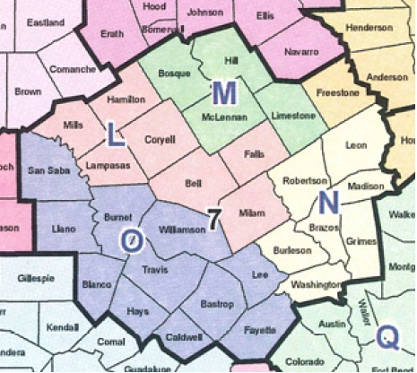
Overview of Ambus Program
Requests for service
  Local
    ATCEMS, AFD, APD
    MCI Plan
    EMS Communications
  Regional
    Regional EMS departments, FD, PD, Emergency Management
  State
  Federal

Slide 8
START Triage Using the SMART System
Should not take more than 30 - 60 seconds
Based on 3 categories (RPM)
  Respiratory Status
  Perfusion Status
  Mental Status
4 Priorities
  Red (Immediate)
    Need care within an hour
  Yellow (Delayed)
    Can wait a few hours for care
  Green (Minor)
    Can wait 24+ hours for care
  Black (Dead)
    Patient is dead

Slide 9
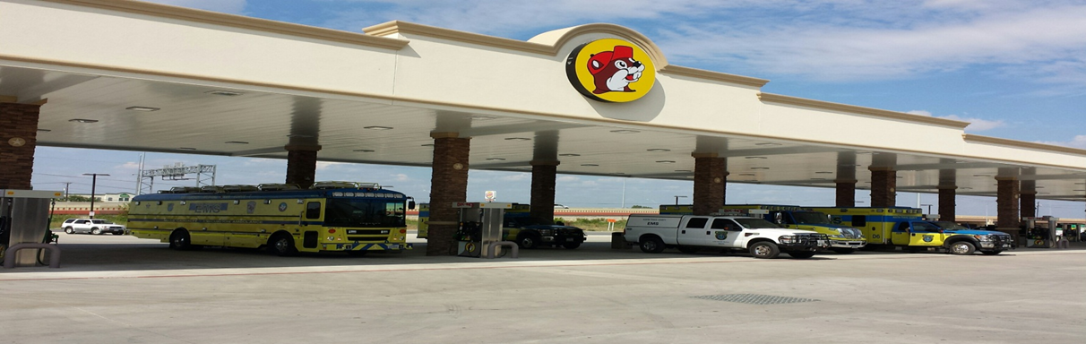
Ambus Operations
Deployment Procedures
  Notice vs No-Notice
  20 Minutes Wheels Rolling for No-Notice
Crew Chief, Driver, and 2-4 Medics

Slide 10
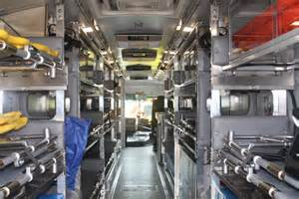
Ambus Operations
Capacities
  20 supine patients or
  20 seated patients
  8 Wheelchairs depending on size
  Neonate isolettes
  100 gallon fuel tank (600-700 miles)
    Approx. 7 mpg
    Also running generator off main fuel tank

Slide 11
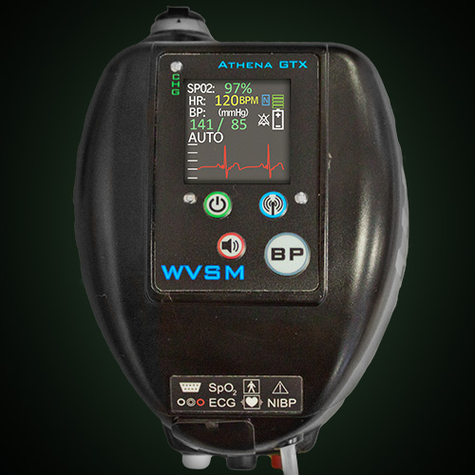
Ambus Operations
Wireless Vital Signs Monitoring Systems
  BP, SPO2, HR, 3 Lead

Slide 12
Ambus Operations
Supplies (Medical and Other)
  2 Full sets of ALS gear
  Heavy on certain medications
    Zofran
    Working on approval for OTC medications
  Heavy on certain patient care items
    Mega movers, urinals, vomit bags, BLS trauma
  Rehab supplies for approx. 30 minutes and 30 persons

Slide 13
Ambus Operations
Loading and Unloading
  18 cots
  2 stretchers
  20 Total Supine areas
  250 pound weight limit
  Rear ramp
  Cots 1-20
Best Practices
  Heavy patients on bottom or middle
  Sicker patients in middle
  Lighter patients on top
  Limit use of stretchers as cots

Slide 14
Recent Deployments
2015 Floods
  Memorial Day
  Halloween
San Saba County
Caldwell County

Slide 15
ICS Sections
Command
One commander or
unified command
PIO
Safety Officer
Operations
(Chief)
Branches
(Branch Director)
Logistics
(Chief)
Planning
(Chief)
Finance / Adm
(Chief)

Slide 16
ICS EMS Branch
ICS Command
ICS Ops Section
(Chief)
EMS Branch
(Branch Director)
Triage Unit
(Leader)
Triage
Personnel
Treatment Unit
(Leader)
Immediate
Minor
Delayed
Transport Unit
(Leader)
Ground
Ambulances
Air
Ambulances
Staging Unit
(Leader)
Ground
Air
Morgue Unit
(Leader)

Slide 17
Mass Casualty Incident (MCI)
Care changes from all resources for one patient to the best care for the most amount of viable patients.
  Cardiac Arrest vs MCI
  Overwhelming resources for cardiac arrest
  Limited resources for MCI

Slide 18
MCI Levels
MCI Type | Number of Patients | AMB | Fire | Command | Executive Assigned | Executive Notified | Additional | Hospitals | Other
 | < 10 | 1 | 1-2 | 0 | 0 | 0 | None | Normal | None
Type 5 | 10-19 | 2 | 2 | 1 | 0 | On Call Division | None | Closest Trauma Center Closest Hospital | None
Type 4 | 20-49 | 6 | 3 | 2 | Division Chief | Division Assistant Chief Medical Director | MPV | All Trauma 2 Closest | CMO MOC CATRAC
Type 3 | 50-99 | 10 | 9 | 3 | 2 Division | All Above | MPV Mutual Aid Air Cap Metro | All Hospitals | All Above EMTF-7 EOC Duty Officer
Type 2 | 100-199 | 15 | 12 | 4 | 2 Division 1 Assistant Medical Director | All Above | All Above Regional MPV 2 Cap Metro | All Hospitals in CATRAC Region | All Above EMTF State Coordinator
Type 1 | 200 | 20 | 15 | 4 | 3 Division 1 Assistant EMS Chief Medical Director | All Above | All Above MMU | All Hospitals on bordering RAC’s | All Above

Slide 19
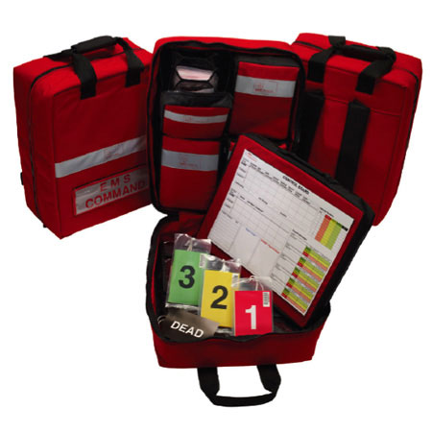
Triage
SMART / START Triage
You may need help
  Each patient will take 30-60 seconds to triage

Slide 20
Triage Unit
Sorts patients
  Sorts to determine the order in which patients will receive medical care and / or transport
  Starts immediately
Primary Triage
    Immediately upon arrival by first crew
  Initial report to commander
  Number of patients and additional resources needed
Secondary Triage
  Happens as patients are moved into triage unit
  May be upgraded or downgraded
    Done by unit leader
  Patients are also re-triaged in treatment unit

Slide 21
Steps to SMART / START Triage
1st step (Walking Wounded)
  Have walking wounded move to safe area
  Tag Green
  Move to respirations for patients not walking

Slide 22
Respirations, Perfusion, Mental Status (RPM)
2nd step (Respirations)
  Open airway
    Possible OPA
  More than 30
    Tag red
  Less than 30
    Move on to perfusion
3rd step (Perfusion)
  Capillary refill more than 2 seconds or absent radial pulse
    Tag Red
  Capillary refill less than 2 seconds and radial pulse present
    Move on to mental status
4th Step (Mental Status)
  Not alert
    Tag red
  Alert to commands
    Tag yellow

Slide 23
SMART / START Triage Practice

Slide 24
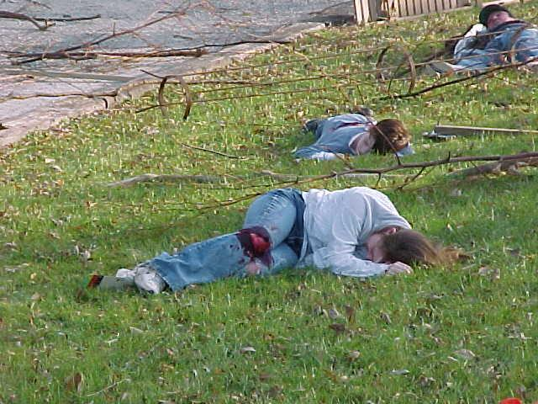
Patient #1
Not walking
Respirations – absent
  Open airway
  Respirations over 30
Tag red

Slide 25
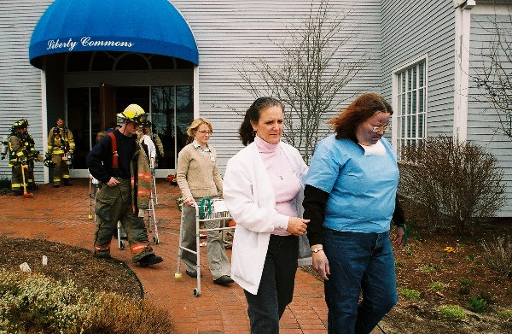
Patient #2
Walking
Tag Green

Slide 26
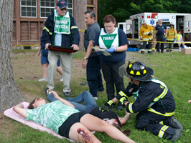
Patient #3
Not Walking
Respirations
  Under 30
Perfusion
  Cap refill under 2 with a radial pulse
Mental Status
  Follows commands and states my leg is broke and really hurts
Tag Yellow

Slide 27
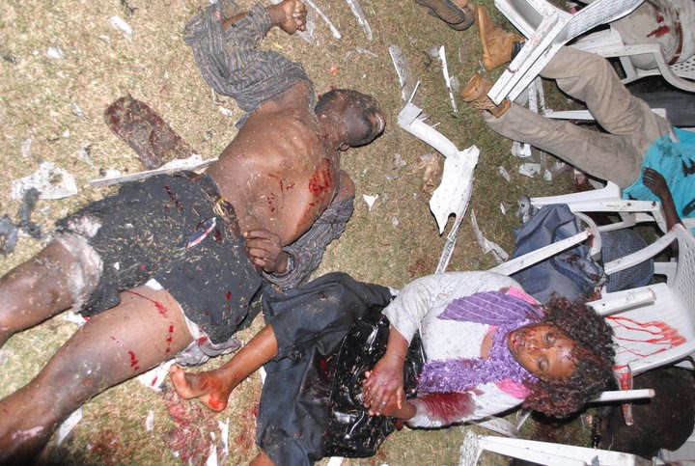
Patient #4
Not Walking
Respirations
  Absent
  Open airway with OPA
  Still absent
Tag Black

Slide 28

Patient #5
Not Walking
Respirations under 30
Perfusion
  Absent radial pulse
Tag Red

Slide 29
Ambus Operations
Questions???
Commander Keith Noble
Austin – Travis County EMS
Emergency Management Division

