Slide 1
medblock
making medical data more secure using blockchain technology, a public ledger that is encrypted and uses mathematical laws for consensus. Through this website and ipfs, we can help hospital patients by allowing them access to their own secure information.

Slide 2
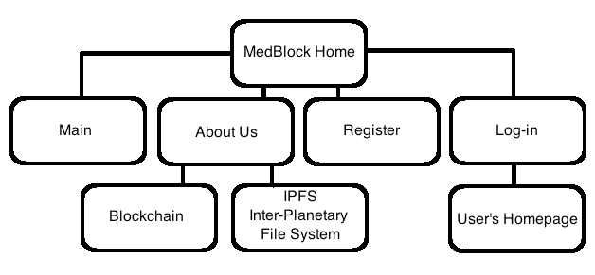
Sitemap

Slide 3
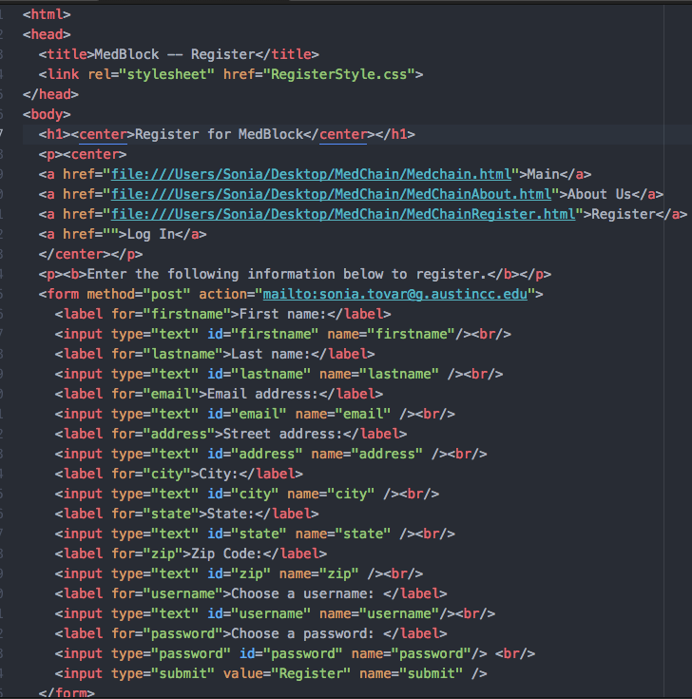
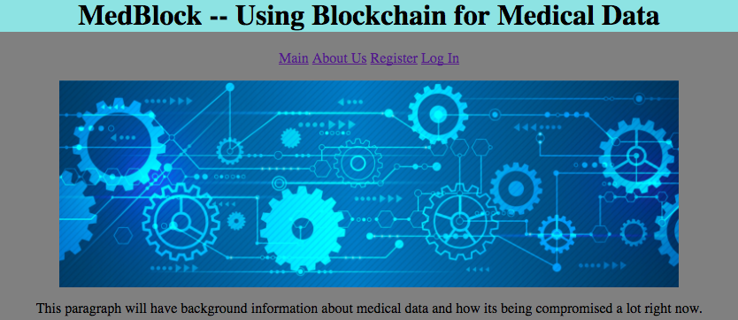
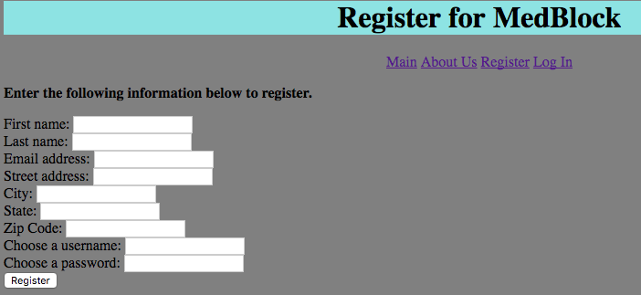
Website Screenshots

Slide 4
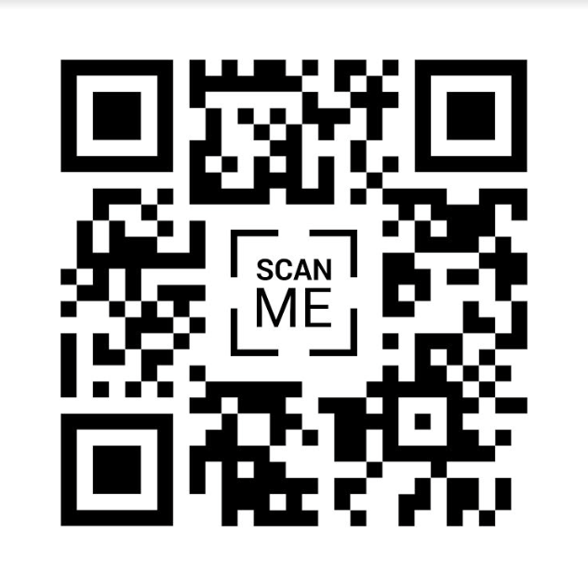
IPFS
Essential to the MedBlock application because it’s more efficient in that it saves bandwith.
This QR code links directly to our node on a distributed file storage network.
The blockchain on MedBlock will pull data from IPFS in order to give you ownership of your digital assets (in this case, personal medical information)

