Slide 1
< Overview >
Recommendation : It is better remove body hair to remove pain
during below system operating
Towel
Air tank
Water Jet
Hole
poop
Dryer
pump
Basket
Poop-->Use Vacuum cleaner to remove it --> water jet to ass hole --> Use Vacuum cleaner again --> hot air to dry.

Slide 2
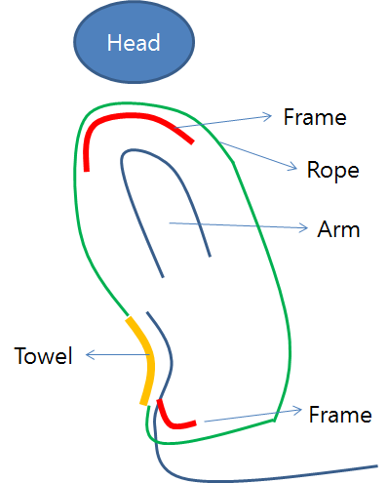
< Detailed >
Towel & Rope
  Towel is connected by closed rope which rope is composed with thin strong but without uncomfortable
  The rope is on some frame over the shoulder and inguinal region in order not to impact body
    The frame could be made anywhere for uncomfortable feeling.
    Frame is covered with cotton for comfortable.
  Towel is located appropriate position by pulling downward or upward.
  If spaceman would like to do poo, he pull the rope downward and do it, after finishing pooing, he locate towel to original position by pulling rope upward.
    So the body of spaceman is maintained dried status every time by this dried towel.

Slide 3
< Detailed >
2. Waterjet & Dryer
  Waterjet is used after pooing.
  Waterjet is connected pump.
  Water for waterjet should be prepared in the back.
  The pump could be operated by hand or electricity system.
  The direction of waterjet is from front to back.
Towel
Hole
Water Jet

Slide 4
< Detailed >
3. Poo Basket and poo removal pump
  After pooing, the poo is moved by pump to basket.
  In order not to contaminate by poo, some frame should be furnished.
  The pump could be operated by hand or electricity system.
  Basket is isolated after pooing by automatic cap.
Towel
Hole
Frame
poop
pump
Basket
Poop-->Use Vacuum cleaner to remove it --> water jet to ass hole --> Use Vacuum cleaner again --> hot air to dry.

