Slide 1
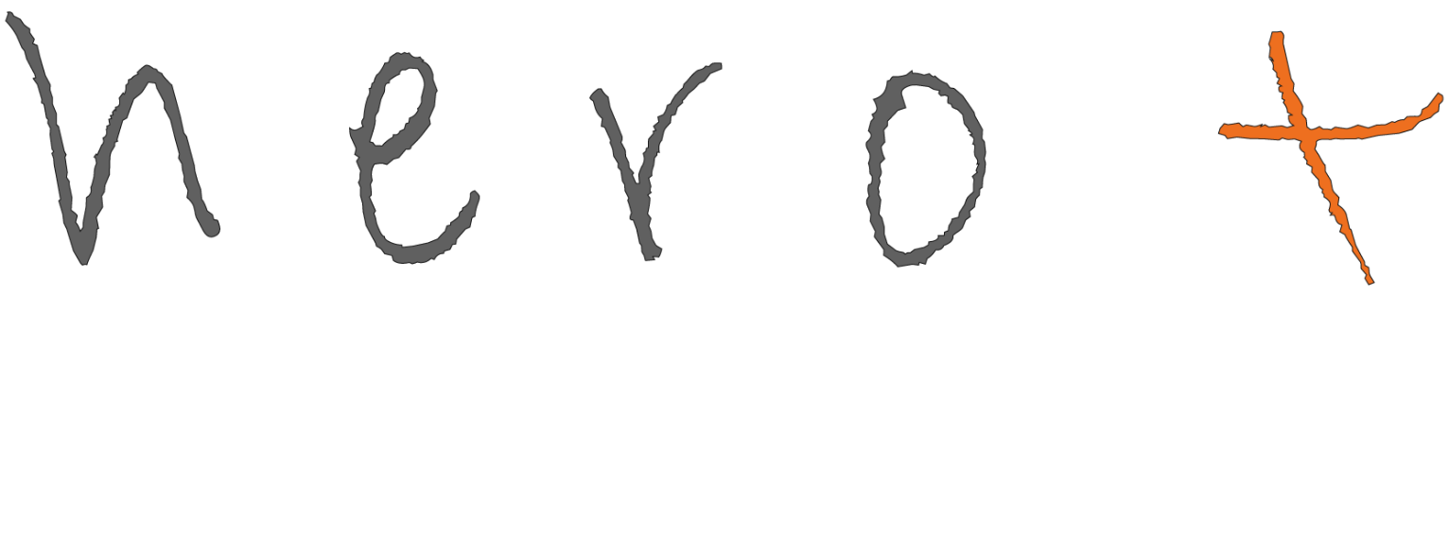

Happier + Healthier + Productive
HeroX december 2016 – Hacking the Work-Life Balance Challenge

Slide 2

It is not only about time. Do you remember last time you enjoyed a task? The balance between work and personal life is about feeling happier and being healthier. Productivity is, some how, the result of an equation in which these are the two variables. So the question is: how in the world we manage these variables in order to achieve the best outcome?
Wake up and play the game. Pick out a brain training app and evaluate how your skills are working today. In this way you will be able to either schedule your tasks or warm up so as to fit in today’s schedule. Say you play the brain training app and your performance is lower than your average in memory and mental agility. If you can schedule your daily tasks, you may want to either delay the tasks in which your memory and/or mental agility is a key skill to achieve a good performance or, if you can not reschedule, you may warm up these skills through some specific training also provided by the app. In this way you will be able to know yourself daily and enjoy the task and the performance achieved becoming happier. So, select a brain training app, create a benchmark, know yourself daily, manage your schedule or warm up, and enjoy your performance.
KEY Strategic Actions
Knowing yourself
Knowing yourself daily
Aligning your Skills
Rhythm
Do it 100%
HeroX december 2016 – Hacking the Work-Life Balance Challenge
Happier + Healthier + Productive

Slide 3
Reach your best rhythm*. Don’t’ get involved too much time on a task; do not get involved in a task without a warm up; be welcome to say “NO” to a task. All your skills can be aligned for you to achieve a good performance. At the time you are feeling this outcome is effortless, you are reaching you best rhythm. There are incredible amounts of physical and physiological alerts your are able to listen on your body. If you train yourself to listen to them, you will experience incredible happiness on your daily tasks (because the tasks will seem effortless) and your health will skyrocket. One of the easy alerts: your posture. How can you train yourself to listen the physical alerts coming from your posture? Very easy. Observe the position of your legs, arms, body, head, hands and feet in two situations: when your task seems effortless (best rhythm) and when you are stressed. Compare them each and be aware on how you evolve into these two different situations. You may notice the pressure you apply to the keyboard with your fingers is much higher when you are losing your rhythm, because the tension on your body unveils itself through your fingers. So start to write down on a handy blog what you see, feel and perceive from your body when you reach your best rhythm and when you are stressed and know yourself.
KEY Strategic Actions
Knowing yourself
Knowing yourself daily
Aligning your Skills
Rhythm
Do it 100%
* Rhythm is my personal way to define the effort level needed to achieve a certain performance.
HeroX december 2016 – Hacking the Work-Life Balance Challenge
Happier + Healthier + Productive

Slide 4
What ever you do, DO IT 100%. My daughter is seven. It is not only Claudia who appreciates to be ACTIVELY LISTENED when speaking, but the effort you put into understanding her changes, whether they are emotional, physical or psychological, is easily bearable when you ACTIVELY LISTEN to her. If you are not into the conversation you are not doing it 100% and in the long term, things may not go as well as you forecasted.
Physical activity is a must for our bodies. Also it is, being social for our happiness. So choose the right partner whether physical activity’s goal is aligning your skills or pushing your performance. But be aware. If you mismatch partner with goal, you will not be training 100% and an inevitable collapse of the forecast with it.
So, wake up, align your skills, reach your rhythm and do it 100%. Whenever you are losing your rhythm, it is time to switch to another activity, task or entertainment that can align your skills again. Get away from anything that destroys your rhythm. Stick to everything that helps you reach that rhythm. Happiness, health and productivity will start to be the description of your life.
KEY Strategic Actions
Knowing yourself
Knowing yourself daily
Aligning your Skills
Rhythm
Do it 100%
HeroX december 2016 – Hacking the Work-Life Balance Challenge
Happier + Healthier + Productive

Slide 5
Lucubrum – Alan N. Ramos
HeroX december 2016 – Hacking the Work-Life Balance Challenge
Hacking the Work-Life Balance Challenge

