Slide 1

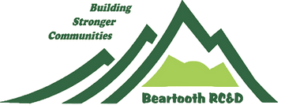
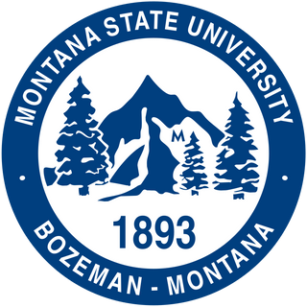
Montana
IP: SD 14858 TWISTACT
Joliet Commercialization Coalition (JCC)
Joliet is a Resource Conservation and Development Priority Area . One of six Brownfields totaling nearly $5.7 million for cleanup and revitalization projects in communities across Montana. We are expediting the assessment and cleanup of brownfield sites while advancing clean energy manufacturing and environmental justice.
Partners: Northern Cheyenne Tribe, Beartooth Resource Conservation & Development, Montana State University Energy Research Institute, Big Sky Economic Development, the United Steelworkers (USW), International Brotherhood of Electrical Workers (IBEW), IEEE Young Professionals, IEEE Power & Energy Society Women in Power Committee, and the IEEE PES Power System Operation

