Slide 1
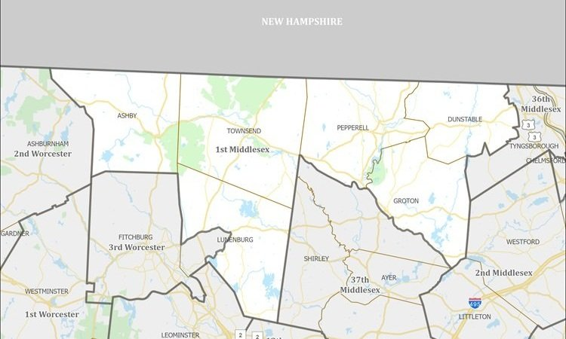
First Middlesex District
2024 Renew America's Schools Prize
First Middlesex District
  Project Description
  Replace outdated HVAC/electrical systems in with clean, energy-efficient systems.
  Summary of Need (Community, Facility)
  Current facilities are largely energy-inefficient, and much of the HVAC systems require frequent maintenance. Large amount of equipment expires soon, and some of the schools lack the funding for necessary replacements.
  Project Goals
  Redirect funds previously used for HVAC/electrical system maintenance and upkeep to improve educational quality.

