Slide 1
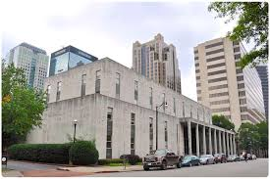
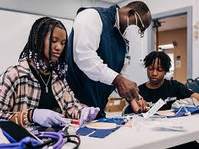
Protect|ED Renew Birmingham City Schools Alabama
2024 Renew America's Schools Prize
  Project Description - 21 K-12 Public Schools and buildings included–all located in Birmingham, Alabama. Project team includes the school districts, Energia, and Protect|ED.
  Summary of Need (Community, Facility) Buildings (ages 11-124) need air quality improvements to help improve student health, attendance, and achievement.
  Project Goal: For Renew Birmingham City Schools, Alabama, the goal is simple: All children learn in healthy, high-quality learning environments. Through improved air quality and energy efficiency, we will see:
Objective #1: A decrease in student and teacher absences, including chronic student absenteeism, leading to improved academic achievement
Objective #2: Significant energy savings that shift real dollars to direct student learning supports leading to improved academic achievement

