Slide 1
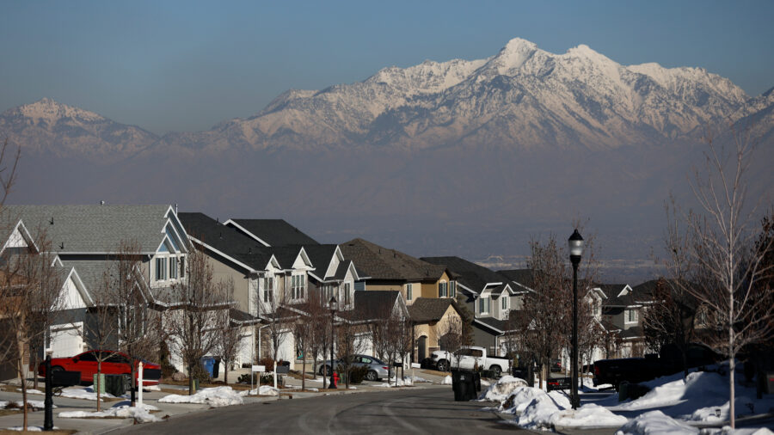
Team Nebo
2024 Renew America's Schools Prize
Renew Nebo
  Project Description
All children learn in healthy, high-quality learning environments - achieved through improved air quality and decrease in energy consumption.
  Summary of Need (Community, Facility)
  All project schools have HVAC systems that are more than 24 years old. Nebo School District lies in the Wasatch Front inversion area in the north and annual fire risk on the east.
  Project Goals
Achieve higher academic achievement by minimizing student and teacher absences, including addressing chronic absenteeism among students
Achieve substantial energy savings, reallocating resources directly towards student learning initiatives, ultimately enhancing academic success

