Slide 1
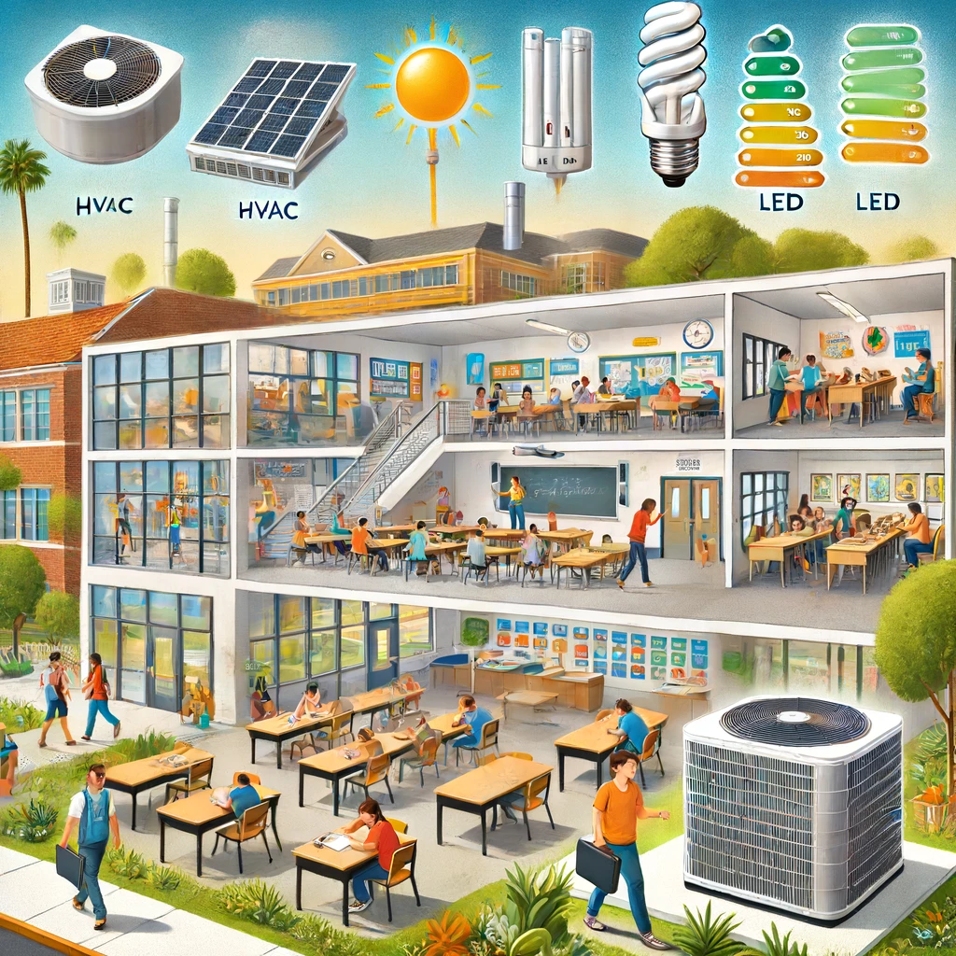
Fullerton Joint Union High School District
2024 Renew America's Schools Prize
Enhancing Efficiency & Learning Spaces at FJUHSD
Project Description
  The project targets ten school facilities within the Fullerton Joint Union High School District. The plan focuses on implementing energy efficiency measures, including HVAC and lighting replacements, to enhance energy efficiency and reduce operational costs.
  Summary of Need
  The identified schools serve diverse communities with high needs. Many facilities are aging, with inefficient systems leading to high energy costs and maintenance challenges. This funding will address critical energy inefficiencies, improve the learning environment, and support the district’s sustainability goals. Additionally, this project will provide long-term financial savings and environmental benefits to the community.
  Project Goals
  Improve Energy Efficiency
  Enhance Learning Environments: Create comfortable, well-lit, and energy-efficient spaces for students and staff.
  Community Benefits: Reduce carbon emissions, lower operational costs, and serve as a model for sustainable practices in education.

