Slide 1
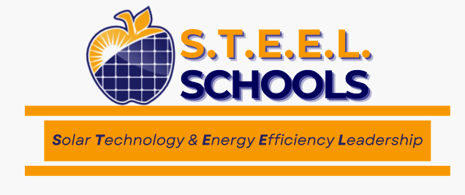
STEEL Schools Team
2024 Renew America's Schools Prize
STEEL Schools (Solar Technology & Energy Efficiency Leadership)
  Project Description
  The STEEL Schools program will transform energy use, create union jobs, enhance student learning, and reduce costs in 20 schools in Western PA through solar energy and energy efficiency. The diverse STEEL Schools Team, with expertise in school administration, solar energy, union labor relations, workforce training, and indoor air quality, will assess and implement these energy upgrades, benefiting both schools and their communities.
  Summary of Need (Community, Facility)
  Once a leader in steel manufacturing and coal mining, this region now faces significant pollution and job losses, leading to a declining tax base for schools. Most of the STEEL schools were built in the 1970s or earlier, with Clairton Middle/High and Crafton Elementary being over 100 years old.
Project Goals
Significantly expand solar and energy efficiency adoption in PA
Address technical and financial obstacles for schools/districts
Meaningfully reduce energy costs and enhance financial security for educational investments
Create healthier & more robust learning environments

