Slide 1
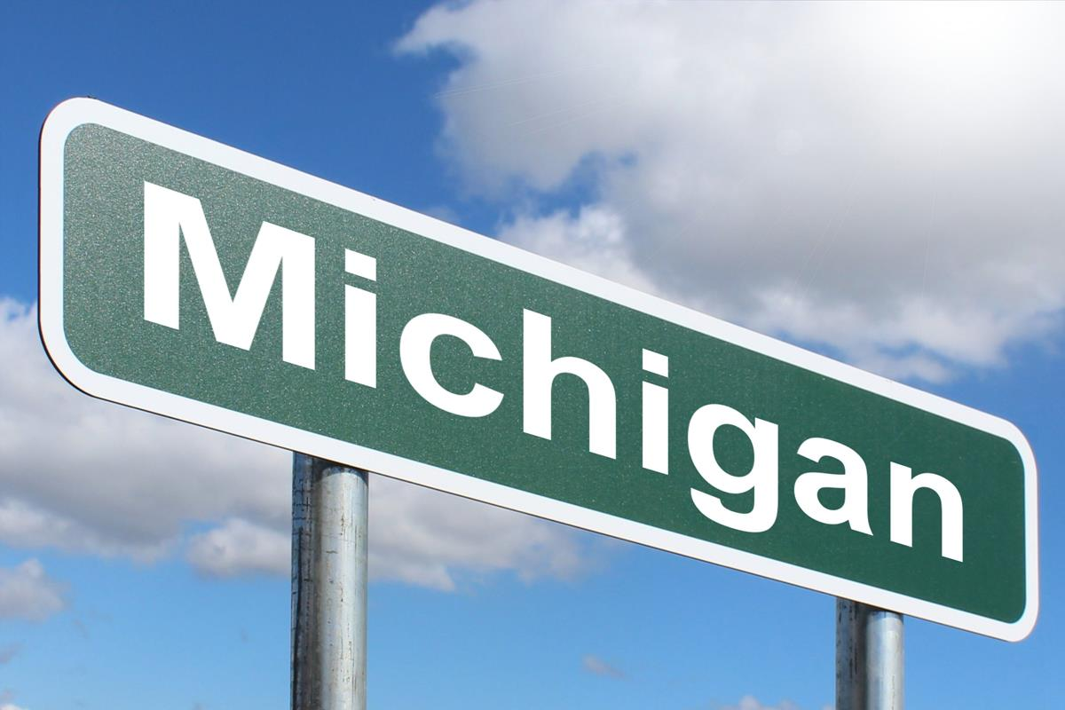
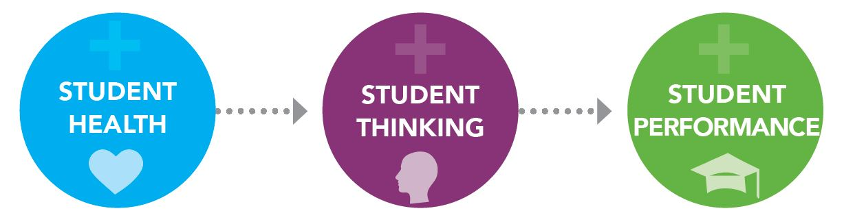
Southeast Michigan K12 Collaborative
2024 Renew America's Schools Prize
Michigan K12 Energy Impacts
  Project Description
  The Southeast Michigan K12 Collaborative includes Ann Arbor Public Schools (AAPS), Detroit Public Schools Community District (DPSCD) and Kingston Community Schools (KCS) with many partners and collaborators.
  Summary of Need (Community, Facility)
  The team includes a diverse group of school district/communities, ranging from the largest school district in Michigan to a small rural district. The majority of the school facilities identified are in disadvantaged communities, and reflect aging and outdated infrastructure with many documented deficiencies that would benefit from the resources and support provided through this opportunity.
  Project Goals
  Reduce Energy Consumption by 30%
  Install Renewable Energy Systems
  Leverage Incentives and Rebate $$$
  Improve Student Health and Well-being
  Enhance Educational Opportunities for Students
  Foster Community Engagement and Collaboration
Credit: Schools.forhealth.org

