Slide 1






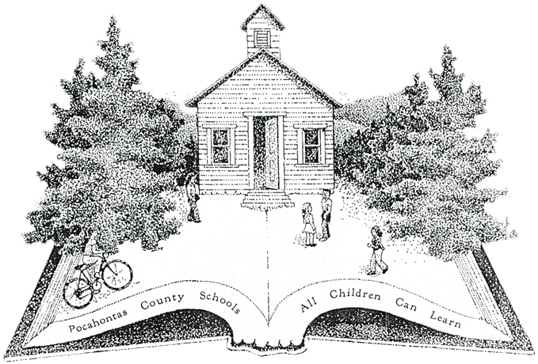
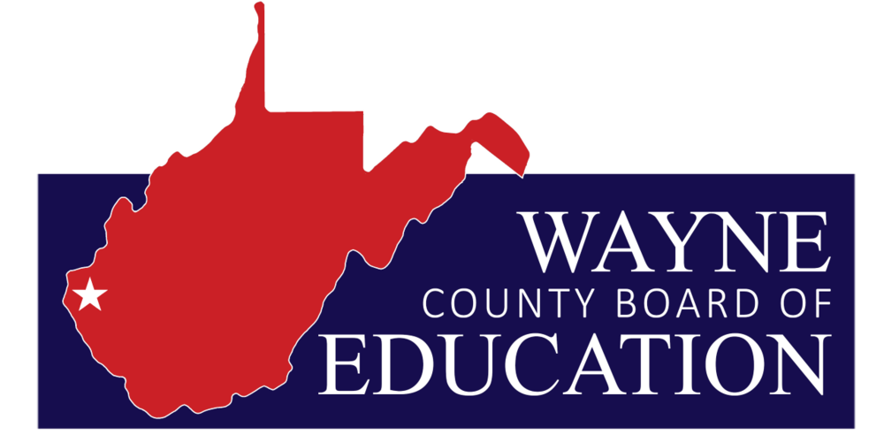
West Virginia Office of Energy (WVOE)
2024 Renew America's Schools Prize
REAL Benefits to West Virginia Schools
  Project Description
  WVOE will improve energy efficiency in Cabell, Kanawha, Pocahontas, and Wayne County schools. The team includes WVOE, AECOM, ASHRAE, and Department of Education. The project focuses on energy-saving measures, renewable technologies, and educational outreach.
  Summary of Need
  With limited budgets West Virginia schools need to reduce their energy burden and upgrade outdated infrastructure which is often in poor condition. This funding, aimed at rural and schools serving disadvantaged communities, will help reduce costs, enhance comfort and health, promote energy conservation, and strengthen the energy workforce pipeline.
  Project Goals
  Boost school energy efficiency allowing savings to be reallocated to education.
  Reduce energy use through efficiency and renewable to increase school resilience.
  Increase awareness of energy conservation measures and energy jobs of the future.
  Increase comfort and health of students, teachers, and school occupants.

