Slide 1








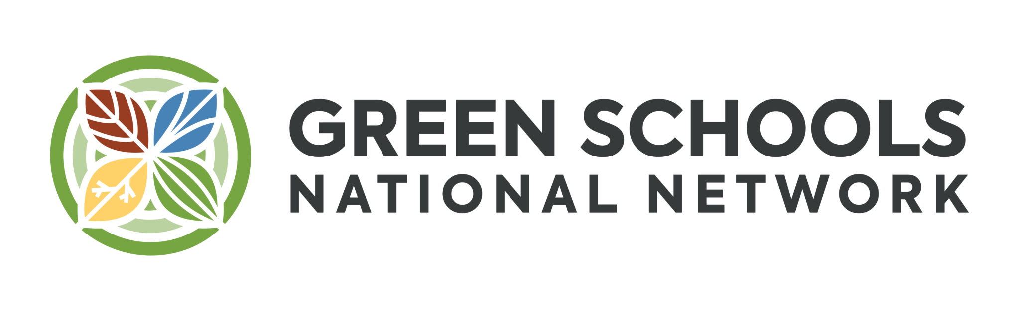












Boise School District
2024 Renew America's Schools Prize
Boise Schools: Powering Energy Efficiency
  Summary of Community & Facility Needs
Boise Schools is primed for impact! We've completed key steps like energy management improvements, GHG studies, and Green Team leadership.
Our team and community stand ready to implement best practices - yet Idaho ranks 49th out of 50 states for spending per pupil, often neglecting building optimization.
The district serves a diverse community with a significant portion of students qualifying for free meals. This is especially true in Community Eligibility Provisions, DAC, and Title I-funded schools, where additional resources are needed.
This award is the perfect opportunity to engage our community, showcase success, and lead other schools, many of which are located in DAC throughout the region in innovative, cost-saving clean
energy projects.
  Project Description & Facility Needs
  School Portfolio: A mix of 18 high-use buildings with varied hardware and high energy usage, presenting major opportunities for efficiency improvements, such as lighting and building envelope upgrades, and renewable energy installations. Some schools have been recently renovated but still have high EUIs. Others require HVAC upgrades to create building comfort, particularly for extreme heat days.
  Phase 2 Technical Project Team Composition: The University of Idaho Integrated Design Lab, internal legal, facilities, leadership, and sustainability support, and external expertise and consultation from tax, engineering, sustainability, public engagement and inclusion subject matter specialists and experts.
  Our Plan: We propose 18 audits, revisions to our procurement policies and contract language, and stakeholder engagement to further develop our Community Benefits Plan and complete a Strategic Plan for Energy Improvements.
and more…
  Project Goals
Increase energy efficiency and reduce GHG emissions while engaging the school and community in sustainability initiatives, and enhancing student education and community benefits.
Document and share successful strategies to become a model for other school districts in the state and region to replicate.

