Slide 1
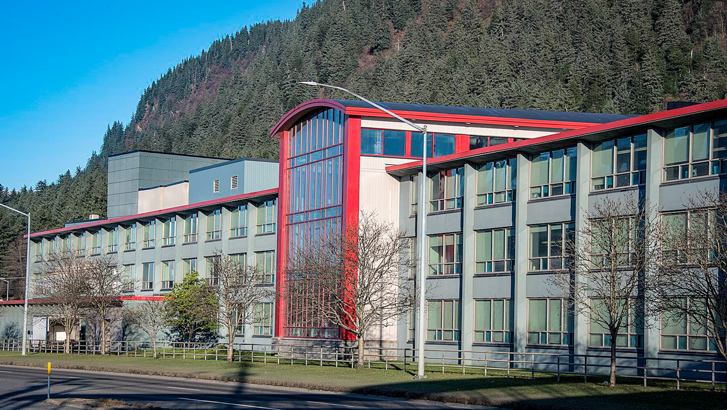
Alaska Municipal League
2024 Renew America's Schools Prize
Reducing the Energy Burden of Diverse Alaska School Districts
Project Description
  The project aims to reduce energy burden through significant GHG emission and comprehensive indoor air risk reductions for schools in low-income, disadvantaged and Tribal communities. The project involves five schools in the Juneau School District, two schools in the Southeast Island School District, and four schools in the Aleutians East School District.
  The team consists of AML’s Erin Reinders and Nils Andreassen, as well as partners from across the state including Alaska Housing Finance Corporation, DEED, IBEW, Alaska Association of School Boards, and SERRC.
  Summary of Need
  The focal point of the project is three school districts located in the vicinity of the Gulf of Alaska, which are in dire need of infrastructure enhancements. Requirements range from replacing costly diesel energy sources to implementing facility upgrades to mitigate heat loss. Communities are considered rural and disadvantaged.
  Project Goals
  Increase energy efficiency of all school buildings lower energy costs for LEAs
  Reduce diesel fuel consumption for power and heating lower carbon emissions.
  Lead to more economically delivered power to community facilities reduce the energy burden.
Juneau-Douglas High School: Yadaa.at Kalé (constructed 1956)

