Slide 1
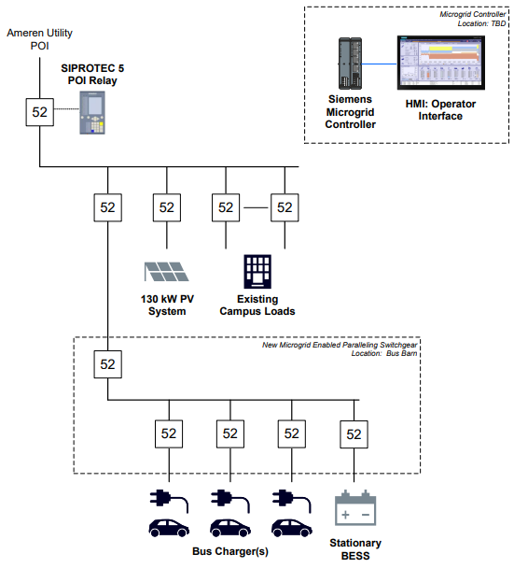
University of Illinois-Chicago
CONTROL NUMBER:
2756-2809
Public School Bus2Grid Microgrids
Project Description
An Innovative Energy Technology Package that combines the power of solar arrays, stationary battery storage, electric school bus batteries, and real-time responsive software to reduce emissions, increase energy resilience, provide emergency assistance and reduce operational costs. This project fuels innovation and interoperability and is scalable nationwide.
Summary of Need (Community, Facility, Fiscal)
Our coalition of 10 sites within 8 Illinois public school districts has a combined enrolment of 19,592 students, 62% of which qualify for free and reduced lunches. Three of our school districts contain Justice40 census tracts. We represent urban, suburban, and rural communities. We anticipate completing Prize Phase 1 with at least 20 school districts in our coalition
Requested DOE funds and proposed applicant cost share
DOE Funds $14,000,000
Cost Share $700,000
  Benefits Metrics
  6,287,572 lbs in CO2 reduction annually
  $690,000 energy cost savings annually

