Slide 1
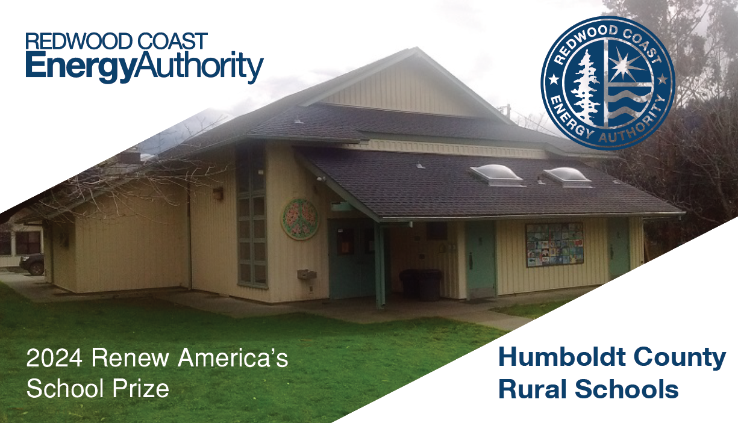
Redwood Coast Energy Authority
2024 Renew America's Schools Prize
Humboldt County Rural Schools
Project Description
Redwood Coast Energy Authority (RCEA) is the prime applicant for the Humboldt County Rural Schools Consortium for the Renew America’s Schools Prize, leading a consortium of 19 rural, isolated, and disadvantaged schools. Humboldt County is in a far northern, isolated region of rural California, experiencing impacts of above-average poverty and unemployment, susceptible to devastating wildfires, storms, and earthquakes, yet underserved by statewide and federal programs.
Summary of Need
  This program will provide an opportunity to bring significant energy improvements, better indoor air quality, resiliency, and substantial benefits in operational efficiency and cost savings to school facilities.
  The average cost per kWh among our 19 school facilities is $0.36, among the highest in the nation. This high electricity cost burdens small rural schools, making essential upgrades difficult to afford. Urgent needs include upgrading old, inefficient, and unsafe HVAC systems, which use natural gas boilers that introduce combustion gases into classrooms. Replacing these with electric heat pumps would improve energy efficiency, indoor air quality, comfort, and reduce greenhouse gas emissions. Other schools, need improvements to windows, roofs, and ventilation to combat heat loss, moisture issues, and poor air quality. Installing double-pane windows, new roofs, and filtered ventilation would enhance energy performance and health, protecting against wildfire smoke and pollutants. Some schools require energy resiliency measures like solar and energy storage systems to handle power outages and natural disasters, increasing their reliability and sustainability while potentially serving as emergency centers for their communities.
Project Goals
The primary objectives of this project are to enhance energy efficiency and secure necessary funding for energy improvement projects across 19 schools, particularly in rural and underserved areas of Humboldt County. Key goals include fostering strategic partnerships to maximize funding impact, developing a detailed Phase 2 execution plan for energy audits and tailored designs, and advancing community benefits through robust engagement, job quality investment, and promoting diversity, equity, inclusion, and accessibility (DEIA). The project aligns with the Justice40 Initiative to ensure 40% of federal investment benefits reach disadvantaged communities. Specific energy improvements will address deferred maintenance, decarbonization, health and safety, and resilience through energy-efficient solutions and the installation of solar and energy storage systems. Expected outcomes include enhanced energy efficiency, reduced greenhouse gas emissions, increased resilience, and significant contributions to the Justice40 Initiative.

