Slide 1
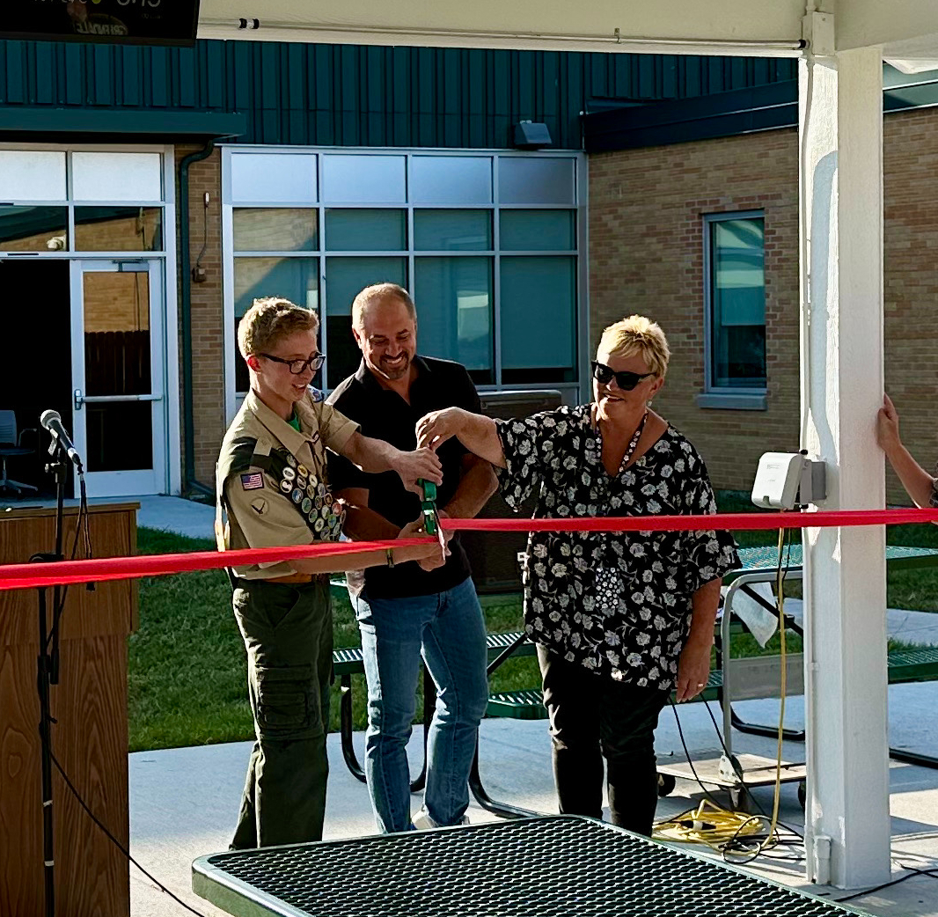
Green Innovators
2024 Renew America's Schools Prize
Joint Energy Efficiency and Sustainability Project for Greendale and Franklin Public Schools
  Project Description
  This project is a collaborative effort between Greendale and Franklin Public Schools that includes five schools from each district. The project team includes each district’s Directors of Business Services and Buildings & Grounds, an energy advisor, and design and construction project management firm
  Summary of Need (Community, Facility)
Our districts are in need of sustainable building improvements. Specifically, we seek to improve HVAC efficiency at College Park Elementary, replace the boilers at Ben Franklin and Pleasantview Elementaries, and install interior LED lighting at Countrydale and Robinwood Elementaries.
  Project Goals
Reduce Energy Consumption
Improve Indoor Air Quality
Promote Sustainability Education
New GHS courtyard ribbon cutting ceremony in 2023.

