Slide 1
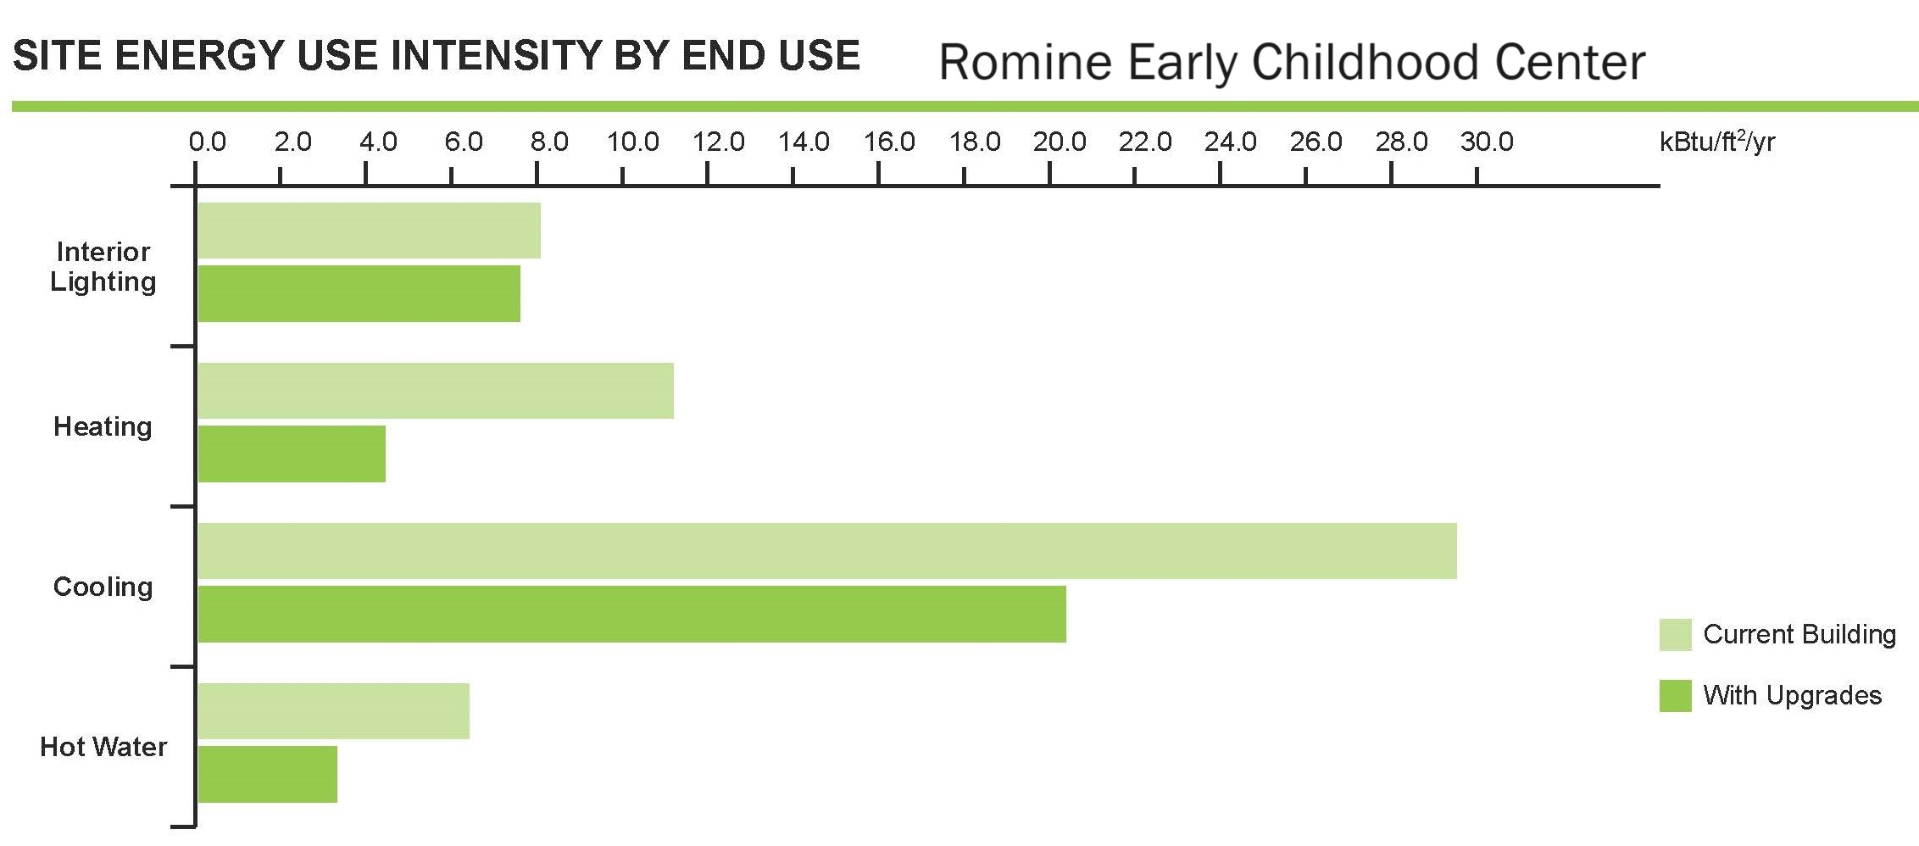
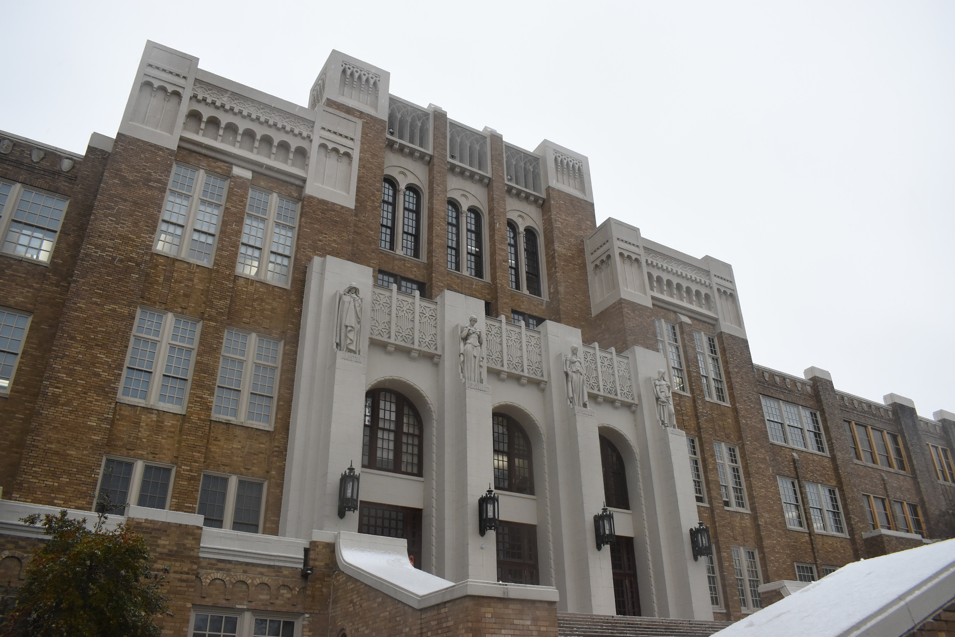
Team Energia/Little Rock
2024 Renew America's Schools Prize
Renew Little Rock Public Schools
Energia, in partnership with Protect|ED and the Little Rock Public School District (LRSD) will provide healthy, high-quality learning environments for 10,083 students and 574 teachers at 17 schools in high-need, disadvantaged communities (DAC) in Little Rock and Mabelvale, AR (Locale- 12-City: Medium). All are Title 1 eligible, and 92.5% of students qualify for the federal free school meals program,
Summary of Need (Community, Facility)
Two targeted schools are on the National Register of Historic Places, Central High School and Dunbar Middle School.
Four of the targeted schools are
Community Schools developed in
partnership between the
City of Little Rock
and the Little Rock School District.
  Project Goals
  Improving air quality and energy savings to:
  Promoting better attendance and enhancing student performance
  Shift energy savings to student learning support
19.9%
anticipated annual energy savings for all schools
11 schools have buildings that are 50 years old or more.
14 schools have HVAC systems that are 25 years old or more.

