Slide 1

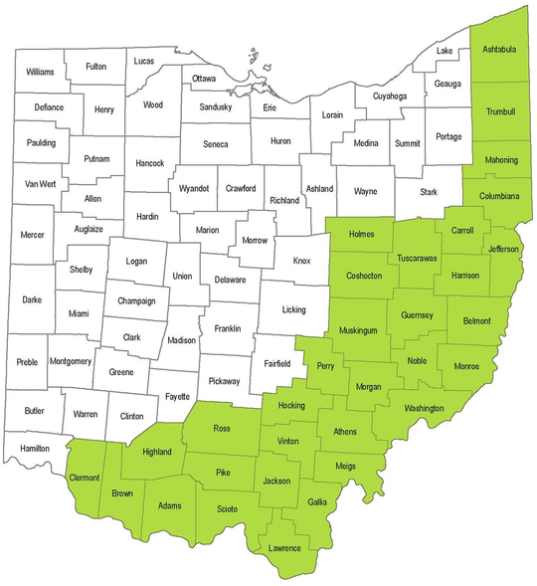
Project Description
Rural Action Energy Team
Rural Action brings together 4 districts and a technical high school, collaborating with our strategic partner, Ameresco, to conduct comprehensive energy audits and data-driven strategies. Our goal is to optimize energy efficiency across these institutions. To facilitate this endeavor, we intend to utilize prize money obtained from the initial phase to alleviate the 5% cost share from the schools. We will then craft tailored energy efficiency plans for each school, offering guidance and support through the implementation process.
Summary of Needs
Schools in Appalachia face unique challenges due to the region’s economic status and historical reliance on fossil energy sources like coal. Limited financial resources, aging infrastructure, and geographic isolation contribute to higher energy costs and environmental impact. Improving system efficiency and transitioning to renewable energy is crucial for these schools to lower expenses, improve sustainability, and overcome systemic barriers to progress.
Empowering Appalachia: A Scholastic Energy Revolution
Project Goals
  Achieve a 25% or higher overall reduction in energy costs.
  Improve classroom comfort levels and indoor air quality.
  Model sustainable energy implementation in rural communities.
  Equip at least one building with efficient backup electricity so it can serve as a community emergency shelter.
  Demonstrate energy-related career opportunities in STEM classes at participating schools.
Ohio’s Appalachian Region
2024 Renew America’s Schools Prize

