Slide 1
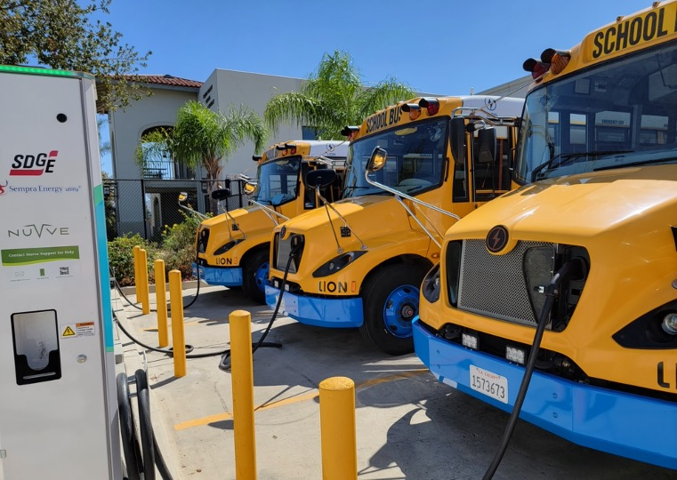
Suisun Bay Synergy Team
2024 Renew America's Schools Prize
Pittsburg (CA) Unified School District
  Project Description
  Energy-Efficiency: HVAC, DHW, LED Lighting, Plug Loads
  Renewable Energy: Solar PV + Battery Storage Microgrids
  Transportation: Managed EV Charging for (52) School District white-fleet vehicles.
  Integrated with community workforce development mentorship program
  Summary of Need (Community, Facility)
Pittsburg Unified School District
A proud but disadvantaged area community (DAC)
Only 10% of the community have a bachelor’s degree or higher.
21% unemployment rate.
Community demographics predominately Hispanic and African American.
85.5% of the students attending PUSD qualify for free and reduced priced meals.
More families rent than own homes.
A helping hand can go a long way, when the community at large is actively engaged in fulfilling its own empowerment.
  Project Goals
Leverage USDOE Renew-America funding:
To create empowering on-the-job workforce training opportunities
To benefit the students in a DAC with accessing career choices in the expanding fields of renewable / energy-efficiency, and electric vehicles.
To attract additional public and private investment in comprehensive energy-savings and electric transportation programs.
To accomplish a significant reduction in energy consumption and agile demand-response, while also positioning the school district to rapidly transition to electric bus and white-fleet vehicles.

