Slide 1
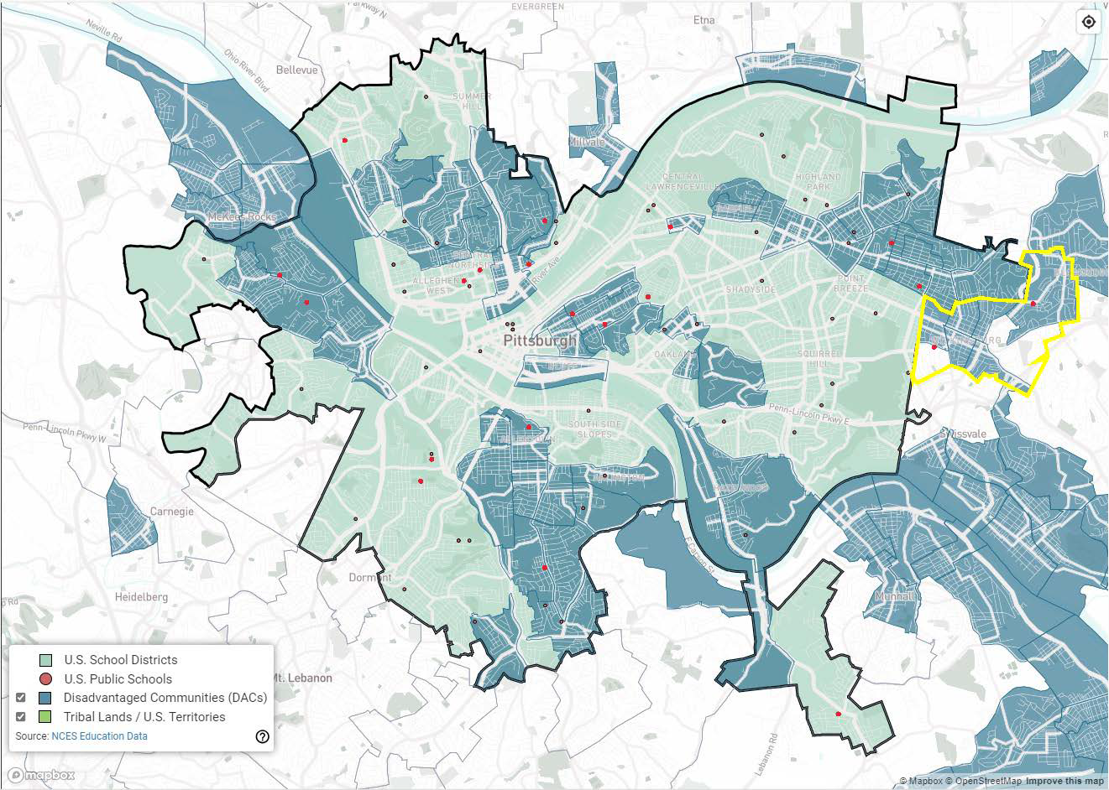
Pittsburgh’s Partnership for Resilient Schools
2024 Renew America's Schools Prize
Project Description
  The School District of Pittsburgh, in partnership with The Efficiency Network, Green Building Alliance, and Wilkinsburg School District will implement a project to provide needed infrastructure upgrades to 18 school buildings across the City of Pittsburgh and two in the adjacent borough of Wilkinsburg. While well-maintained, the buildings need key energy and mechanical system upgrades, presenting an opportunity for improvements that will provide significant and meaningful energy and operational savings to both districts.
  Summary of Need (Community, Facility)
  16 schools exhibit a high need (poor condition) and 4 exhibit a medium need (fair condition) for energy assessments and improvements
  Climate change has significantly accelerated the need for air conditioning, as high temperatures are forcing schools to move to remote learning on an increasing basis
  12 of 20 schools reside in Disadvantaged Communities (DACs) and all serve students who predominantly reside in DACs
  All 20 schools qualify for Schoolwide Title I funding
  86% of students qualify as economically disadvantaged
  Project Goals
  Dampen the impact of lost tax revenue
  Ready consolidated portfolio of schools for increased occupancy
  Catch up on deferred maintenance and ensure receiving schools provide an energy efficient and safe learning environment
  Significantly increase the percentage of disadvantaged community schools with air conditioning.
  Prepare the workforce of the future

