Slide 1

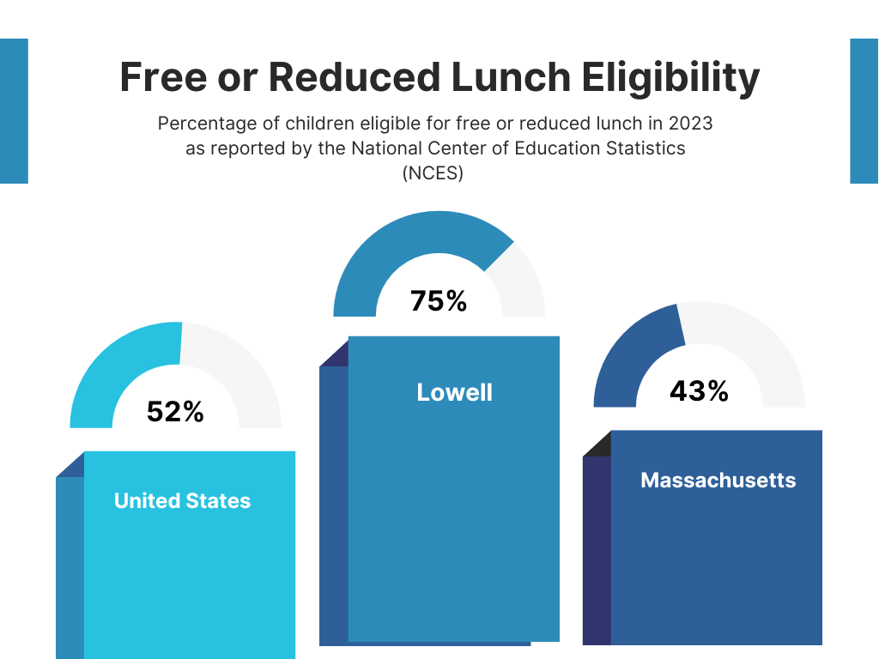
Lowell Public Schools
2024 Renew America's Schools Prize
RELIEF (Reducing Emissions in
Lowell Through Infrastructure
and Energy Efficiency First)
  Project Description
  Our project will transform our schools by conducting a detailed assessment for energy upgrades, led by a seasoned team with over 22 years of expertise. This initiative aims to significantly reduce emissions and create safer, more comfortable learning environments for our students
  Summary of Need (Community, Facility)
  With over $100 million in capital improvement needs and school day closures due to extreme heat, students’ safety and comfort are compromised. By improving school buildings and increasing energy efficiency through weatherization, Lowell can provide a safe, comfortable learning environment for all students in our portfolio, 75% of which live in DAC areas and/or quality for free or reduced lunch.
  Project Goals
  Assess facility needs for energy upgrades, reduce energy use and emissions, and engage students and parents while promoting diversity and inclusion in contractor selection.

