Slide 1
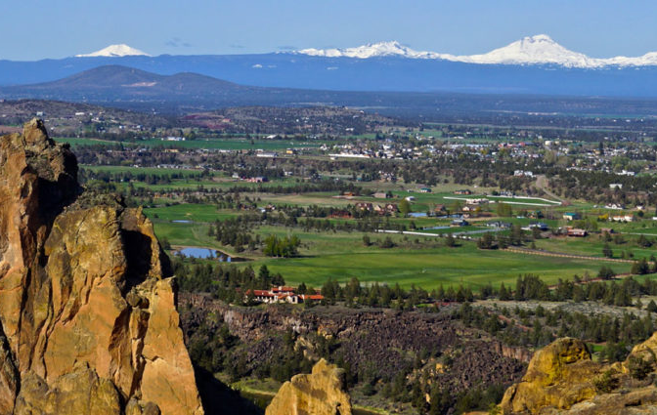
CASCADE COMMUNITY BUILDERS
Improve the learning environments of rural Oregon schools by:
replacing windows,
upgrading lights to LEDs with modern controls,
replacing leaking roofs,
and replace failing siding
Community Benefits
Healthier and Safer schools
Long-term economic and environmental sustainability for the community
Expanding local contractors knowledge

