Slide 1

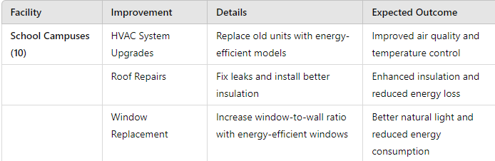
East St. Louis School District 189
2024 Renew America's Schools Prize
School District 189’s Quest to Energy Efficiency
  Project Description
  School District 189 is requesting funds to enhance the energy efficiency of 10 school campuses, one district office, one family engagement center, and one athletic stadium. This initiative aims to improve the health and safety of the facilities' occupants. SD 189 is partnering with Holland Construction Services and Ameren Illinois to conduct audit assessments of the current energy efficiency needs and provide necessary recommendations.
Summary of Need (Community, Facility)
School District 189 is situated in a high-poverty community and operates as a "cash poor" district. The district’s campuses and buildings face several critical issues, including:
Poor air quality
Below recommended window-to-wall ratio levels
Roofs and HVAC systems in need of immediate repair
The funds from this project will address these urgent energy efficiency needs, significantly improving the learning and working environment for students and staff.
  Project Goals
  Many students in School District 189 are “school dependent,” spending more time on campus than off campus. The primary goal of this grant is to make the district more energy efficient, thereby eliminating risk factors that could negatively impact the health of the students and the broader community. By achieving this goal, the district aims to provide a safer and healthier environment for its students, ensuring their well-being during the extensive time they spend at school.

