Slide 1

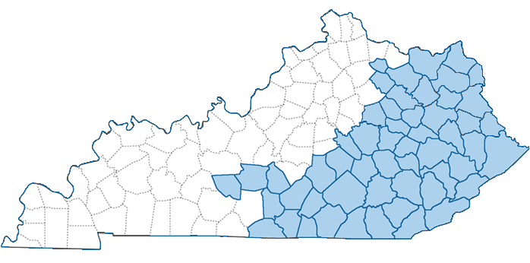
Team
Renew Kentucky Appalachia
Carter Co., Johnson Co., Magoffin Co., Morgan Co., Rockcastle Co., Martin Co. Schools
2024 Renew America's Schools Prize
Project Description
Renew Kentucky Appalachia includes 26 schools and three district facilities needing improvements to energy and air quality to reduce energy costs and chronic absenteeism more than 3x the national average. All schools in our portfolio are Title 1 schools in DOE designated Disadvantaged Communities.
Summary of Need (Community, Facility)
Students in our six partner districts (locale codes 32, 33, 41, 42, 43) have significant challenges to overcome -
generational poverty (26.82% live in poverty) and low family income – 72% less than natl. avg, 38% less than KY average; and
trying to learn in school facilities in poor condition with aged, inefficient systems (avg. HVAC system=21 yrs) - to name two.
To overcome Districts’ inability to afford to address the poor condition/inefficient, costly systems, Federal & private investment in energy efficiency/savings and air quality is needed.
  Project Goals
  Improving air quality and energy savings to:
  Reduce chronic absenteeism
  Shift energy savings to student learning support
10,717 students, 719 teachers, 29 buildings
69.2% Free/Reduced Lunch
1 in 2 Students
Chronically Absent
69.9% Economically Disadvantaged
1
5
2
3
4
Renew KY App.
Carter
Johnson
Magoffin
Martin
Morgan
Rockcastle
6
Appalachia Kentucky

