Slide 1
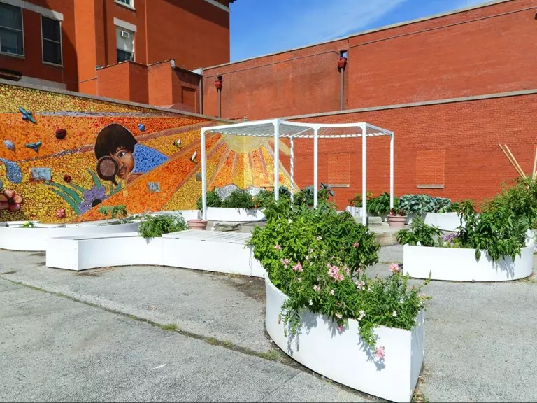
Chicago Public Schools
2024 Renew America's Schools Prize
Urban Resiliency Centers Network
  Project Description:
  Provide a short description of the portfolio of schools identified, the project team, and the proposed plan.
Twenty Chicago Public Schools (CPS) secondary schools will create a Resiliency Center Network of facilities with the ability to operate during extreme weather conditions and natural disasters events because of self-sufficient renewable energy and building operations systems. In times of need, these facilities will be resource centers while providing shelter, warmth or cooling, clean water and other support for the community. They encompass 42 buildings with an average of 56 years old, 4,744,324 square feet of space and service a population of 24,014 students. The Prime recipient of the project will be the CPS Capital Planning Department, led by the Energy and Sustainability Team. Key Team Members include: The 20 Schools, their related Local School Councils, Elevate Energy, CannonDesign, Local Labor Union partnerships, City and State government agencies, and the CPS Office of Budget and Grants Management.
  Summary of Need (Community, Facility):
  Provide a short summary of need and motivation for applying for this funding opportunity.
19 of the 20 schools are in Justice40 disadvantaged communities, with 86% of students who live within 185% of the federally-designated poverty level, 70% of whom are Latino/X and 24% Black/African American. The schools have a combined annual energy usage of over 433,000 mmBtu’s that equates to just over $6,200,000 in costs for both electricity and natural gas. They also have $200,200,000 of near-term, 6-years or less, deferred maintenance critical HVAC equipment upgrades need, and $115,240,000 of critical roof replacement need. CEJST data show that the majority of these communities are flood prone, within proximity of diesel fumes, wastewater discharge, hazardous waste and risk management facilities, experience asthma, poverty, unemployment, and lead paint exposure, among others.
  Project Goals
Goal #1 - Develop a network of facilities that have the ability to operate during extreme weather conditions and natural disasters events through self-sufficient renewable energy and building operations systems
Goal #2 - Establish Best Management Practices for Whole Building Electrification of public education facilities
Goal #3 - Grow community based programs that support career and technical education focused on clean energy and green technology
Goal #4 - Community engagement activities to ensure meaningful participation

