Slide 1
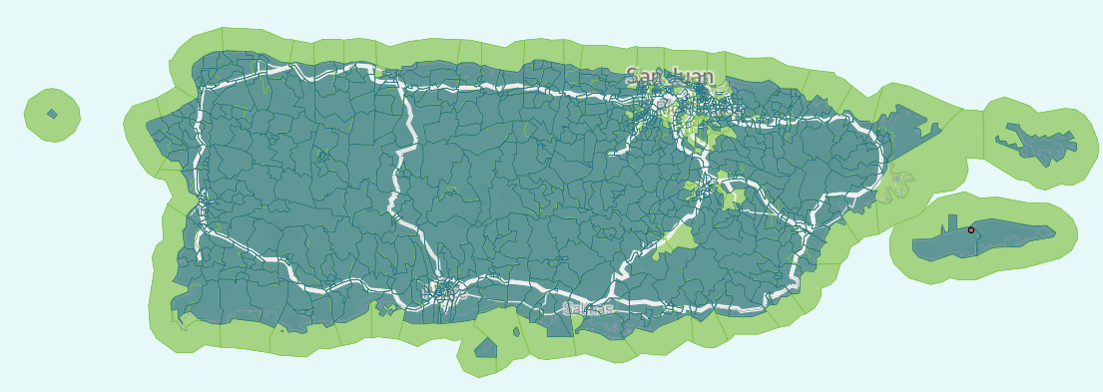


Resiliencia Para Puerto Rico
2024 Renew America's Schools Prize
Creating a Healthy Learning Ecosystem in Puerto Rico
  Project Description
  The portfolio consists of rural and disadvantaged schools across the archipelago of Puerto Rico, including those which have historically faced educational disruptions as a result of poor energy access. This project proposes to provide schools with energy efficiency and resilience upgrades, including solar systems and efficient cooling appliances.
  Summary of Need (Community, Facility)
  The educational facilities in Puerto Rico are basic exposed structures, most which have sustained damage from Hurricane Maria in 2017 and Hurricane Fiona in 2022. Occurrence of mold and heat-related illness is not uncommon. Over 90% of student beneficiaries qualify for free or reduced lunch and 100% are minorities living in a disadvantaged community.
  Project Goals
  This project aims to provide historically underserved and disproportionately at-risk students with access to technologies that improve and protect their health, learning environment, and physical environment through clean air and access to sustainable energy technologies.

