Slide 1
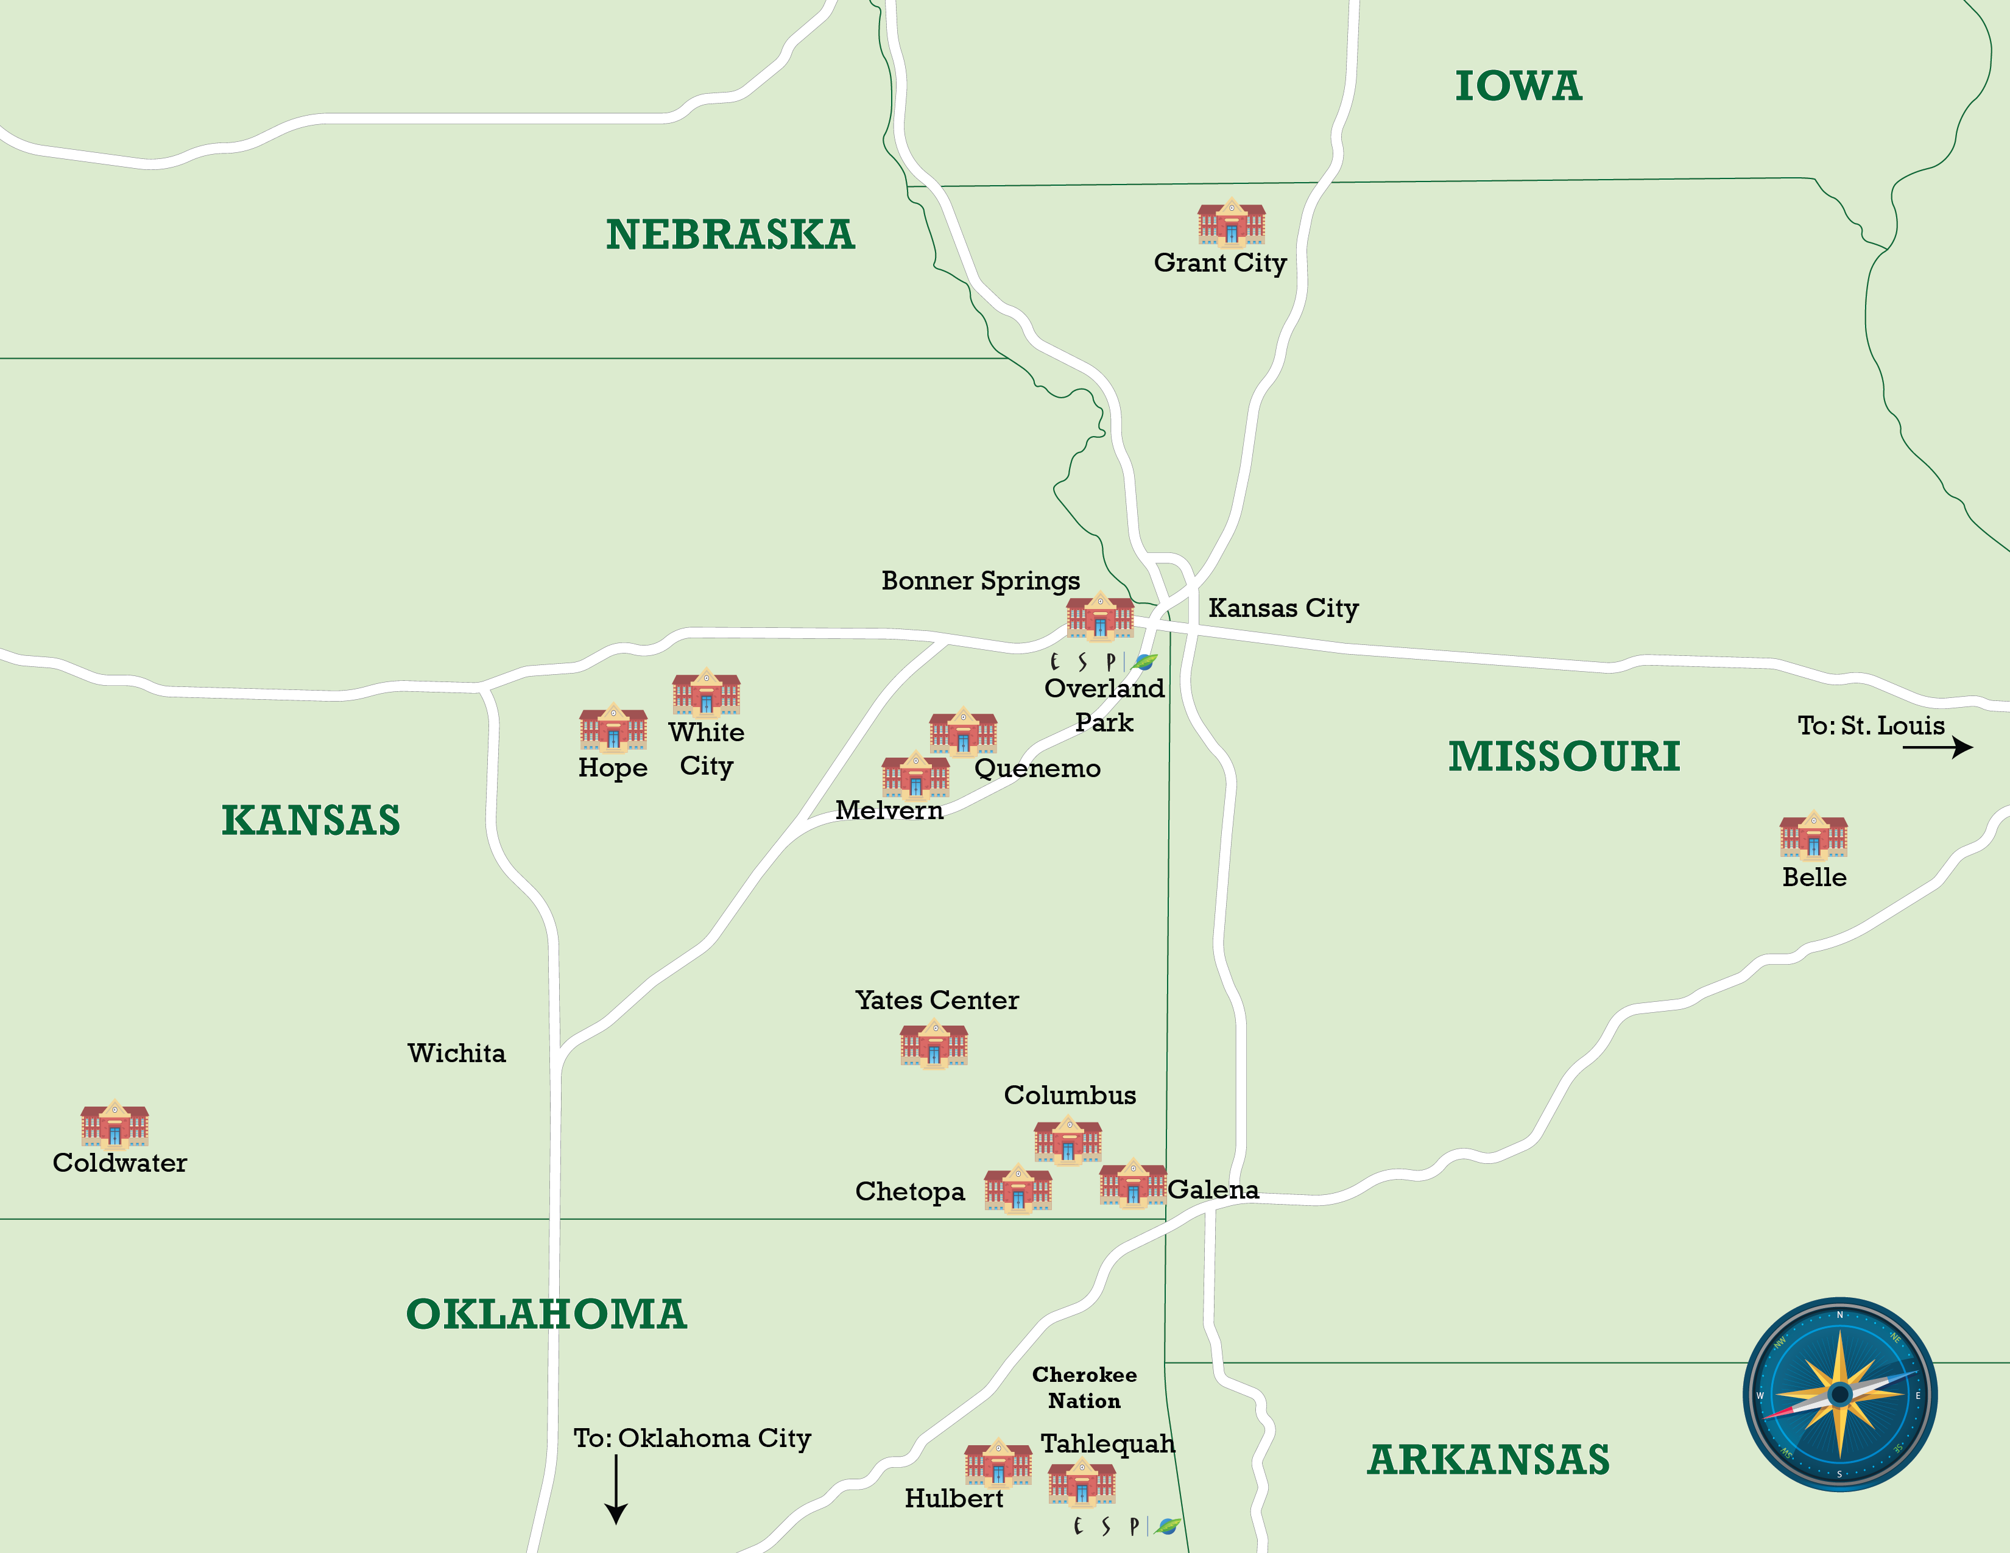
Energy Solutions Professionals
2024 Renew America's Schools Prize
  Tri-State Power UP
  Addressing under-served regions of three heartland states, the Tri-State Power Up portfolio will energize 20 schools and communities in Kansas, Missouri and the tribal lands of northeast Oklahoma. Led by Energy Solutions Professionals, projects will support districts on the path to better building performance with efficient equipment and clean energy upgrades.
  Summary of Need
  16 schools in rural/remote NCES 42/43 locales
  14 Disadvantaged Communities (DACs)
  Widespread aging HVAC, building envelope, IAQ flaws
  Opportunity for tangible local engagement to promote workforce, quality job, DEIA and Justice40 goals
  Project Goals
Provide LEAs with in-depth expertise on energy solutions and financial strategies from a NAESCO- accredited energy services company (ESCO)
Design and develop energy plans that meet the needs of a new generation of school leaders
Engage stakeholders to emphasize local workforce and community investment

