Slide 1
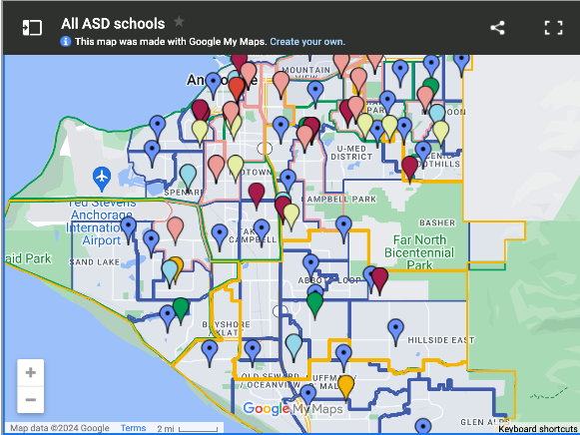
Anchorage School District
2024 Renew America's Schools Prize
Improving Energy Efficiency in Alaska
  Project Description
  Anchorage School District proposes a comprehensive energy efficiency audit of 18 schools across one of the most geographically and culturally diverse school districts in the country.
  Summary of Need (Community, Facility)
  With 91 facilities, including schools and support buildings, and an average building age of 37 years, ASD manages a vast physical plant worth approximately $2 billion. ASD faces a deferred unfunded sustainment backlog of ~$1.073B, resulting in an FCI of ~0.46. Best practices suggest reinvesting 4% of the Current Replacement Value (CRV) annually into capital projects, equating to $80M/year for ASD.
  Project Goals
  The project is designed to mitigate significant public health risks posed by indoor environmental contaminants commonly found in homes, schools, offices, and nonindustrial commercial buildings, where Americans spend up to 90 percent of their time.

