Slide 1
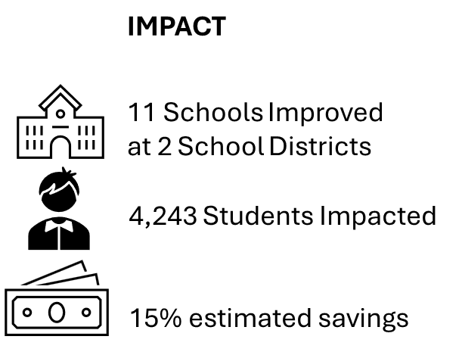
Team Name
2024 Renew America's Schools Prize
Submission or Entry Title
  Project Description
  Florence County School Districts 3 & 5 have teamed up to do a comprehensive energy savings project across both districts. FSD5 will focus on building automation, while FS3 will focus primarily on mechanical upgrades.
  Summary of Need (Community, Facility)
  All but one of the schools in this project are located in Disadvantaged Communities. 10 of 11 schools are at 100% Free and Reduced Lunch Participation Rate. Every school has deteriorated infrastructure and a tremendous need for updates to achieve energy savings and resiliency.
  Project Goals
  G1: Improve school infrastructure
  G2: Increase energy savings and improve financial resiliency and air quality
  G3: Create a foundation for future energy savings projects beyond this funding

