Slide 1
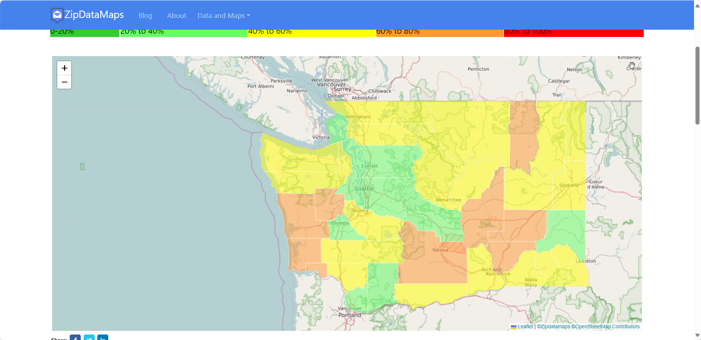
WashingtonCleanSchools
2024 Renew America's Schools Prize
WashingtonCleanSchools
  Project Description
  The mission of WashingtonCleanSchools is to create a collaborative which leverages local, utility, Federal and state resources to address two key barriers to delivering healthy and efficient buildings in rural and disadvantaged schools in Washington: access to technical expertise and funding.
  Summary of Need (Community, Facility)
  Schools play a central roles by creating a sense of community as well as educating students. Schools in remote and disadvantaged Washington communities lack sufficient tax bases to properly maintain facilities to offer healthy and effective learning environments. Most districts cannot afford to perform basic maintenance to keep equipment functioning and all spaces usable. Facilities have failing envelopes, outdated lighting and non-working HVAC and hot water systems which increases operating costs. Faced with unfunded mandates to perform audits and improve their facilities, schools have no practical way to meet these needs.
  Project Goals
  This project will improve building performance and occupant health across our cohort while preparing schools to meet the stringent requirements of the Clean Buildings Performance Standard. The project will reduce EUIs, develop professional relationships across the state, and develop a process to replicate across the Pacific Northwest.
Okanogan
10
Aberdeen
Ellensburg
1
9

