Slide 1
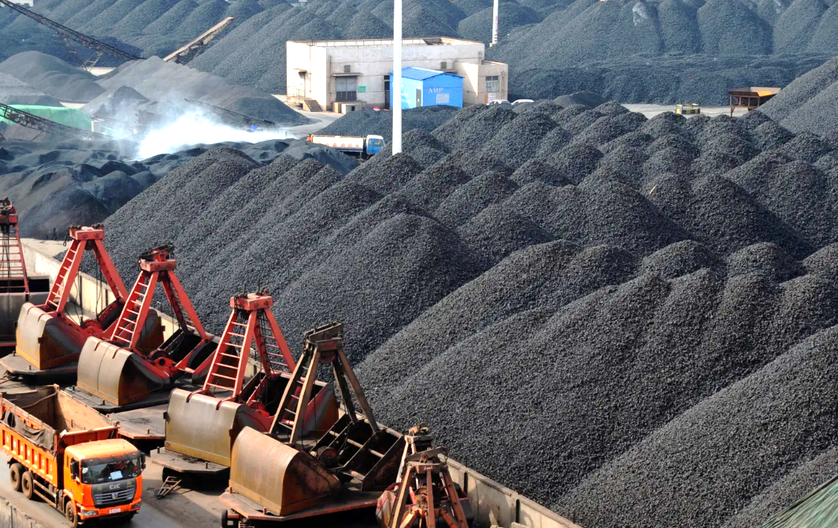

Adams County Ohio Valley School District (ACOVSD)
2024 Renew America's Schools Prize
From Coal to Clean Energy: ACOVSD’s Net Zero Future
  Project Description
  Our proposed project will repair or replace failing building infrastructure in the district, addressing deferred maintenance, substantially improving building efficiency, reducing GHG emissions, and adding renewable energy.
  Upgrades would include LED lighting, controls, and HVAC equipment replacements (including minimizing propane use and eliminating fuel oil consumption). The project aims to achieve net-zero status at one building through a geothermal conversion, the expansion of solar PV with battery-energy-storage, and other upgrades. This would be the first building to obtain this status for a public school in Ohio. To further aid in the districts’ net-zero future, the project would provide canopy-mounted solar PV generation for recently acquired EV buses.
  Summary of Need
  ACOVSD is a rural Appalachian district in a county with the second highest poverty rate in the state, 22.6% and ranks 81/88 for health outcomes. All ACOVSD schools are in Disadvantaged Community zones and qualify for schoolwide Title 1 funds.
  Critical deferred maintenance: leaking roofs, failed or past end-of-life HVAC equipment, aging or non-existent control systems, and buildings in need of LED lighting. Failing water-source heat pumps require constant attention and there is no solution in sight.
  Financial distress: $12M in unmet facility needs, a forecasted $4M operating deficit next year, the loss of tax revenue due to coal plant closures, and difficulty passing school levies in an impoverished community.
  Project Goals
  Address deferred maintenance while reducing GHG emissions; Prepare for the switch to electric buses; Create energy and operational savings; Utilize investment tax credits for match requirements.
  Free up funds for academic and support services; Provide 2-4 apprenticeship opportunities during construction; Employ local and regional diverse workforce.
  Create community benefits for a high need population; Create learning opportunities and foster pathways to quality jobs; Real-time energy dashboard provides a visual tool for educators and the public.
  Make ACOVSD a premier example of what a disadvantaged rural district can accomplish toward becoming a net-zero school system.
This project aims to create the first Net Zero K-12 facility in Ohio, in the heart of what was once "Coal Country."

