Slide 1
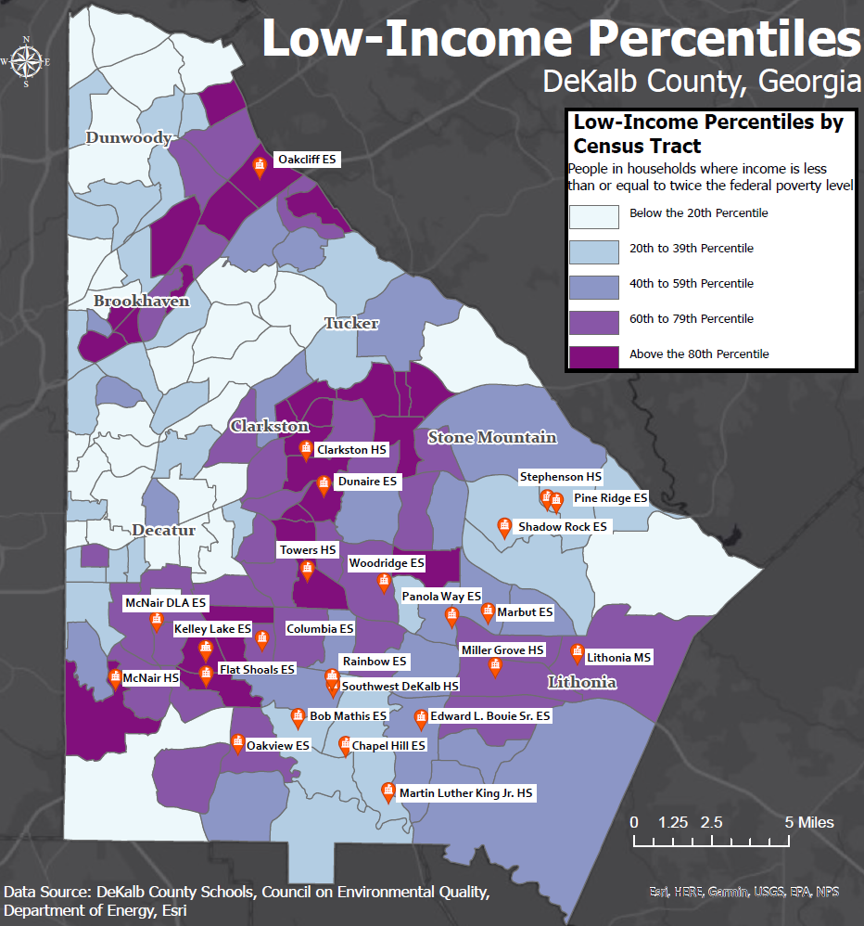
Renew DCSD’s Schools Team
2024 Renew America's Schools Prize
DeKalb Schools Infrastructure Modernization (DeKalb SIM) Project
The DeKalb County School District (DCSD) has formed a collaborative partnership with Southface Energy Institute, Inc. (Southface) to identify and invest in infrastructure improvement opportunities at 24 schools located in DeKalb County, Georgia, primarily in census tracts with above-50th-percentile low-income families. Twelve (50%) of the selected schools are located in the designated Disadvantaged Communities (DACs).
The project's goals are to identify energy-efficiency opportunities, improve inefficient school infrastructures, increase electricity grid resiliency, and properly manage indoor air quality.
The improvements under consideration for implementation include upgrades to HVAC systems and boilers and water heaters, installation of occupancy sensors and tunable LED classroom lighting, replacement of inefficient single-pane windows, installation of roof-mounted solar panels, establishment of indoor air quality systems, and other energy efficiency upgrades.
  .

