Slide 1

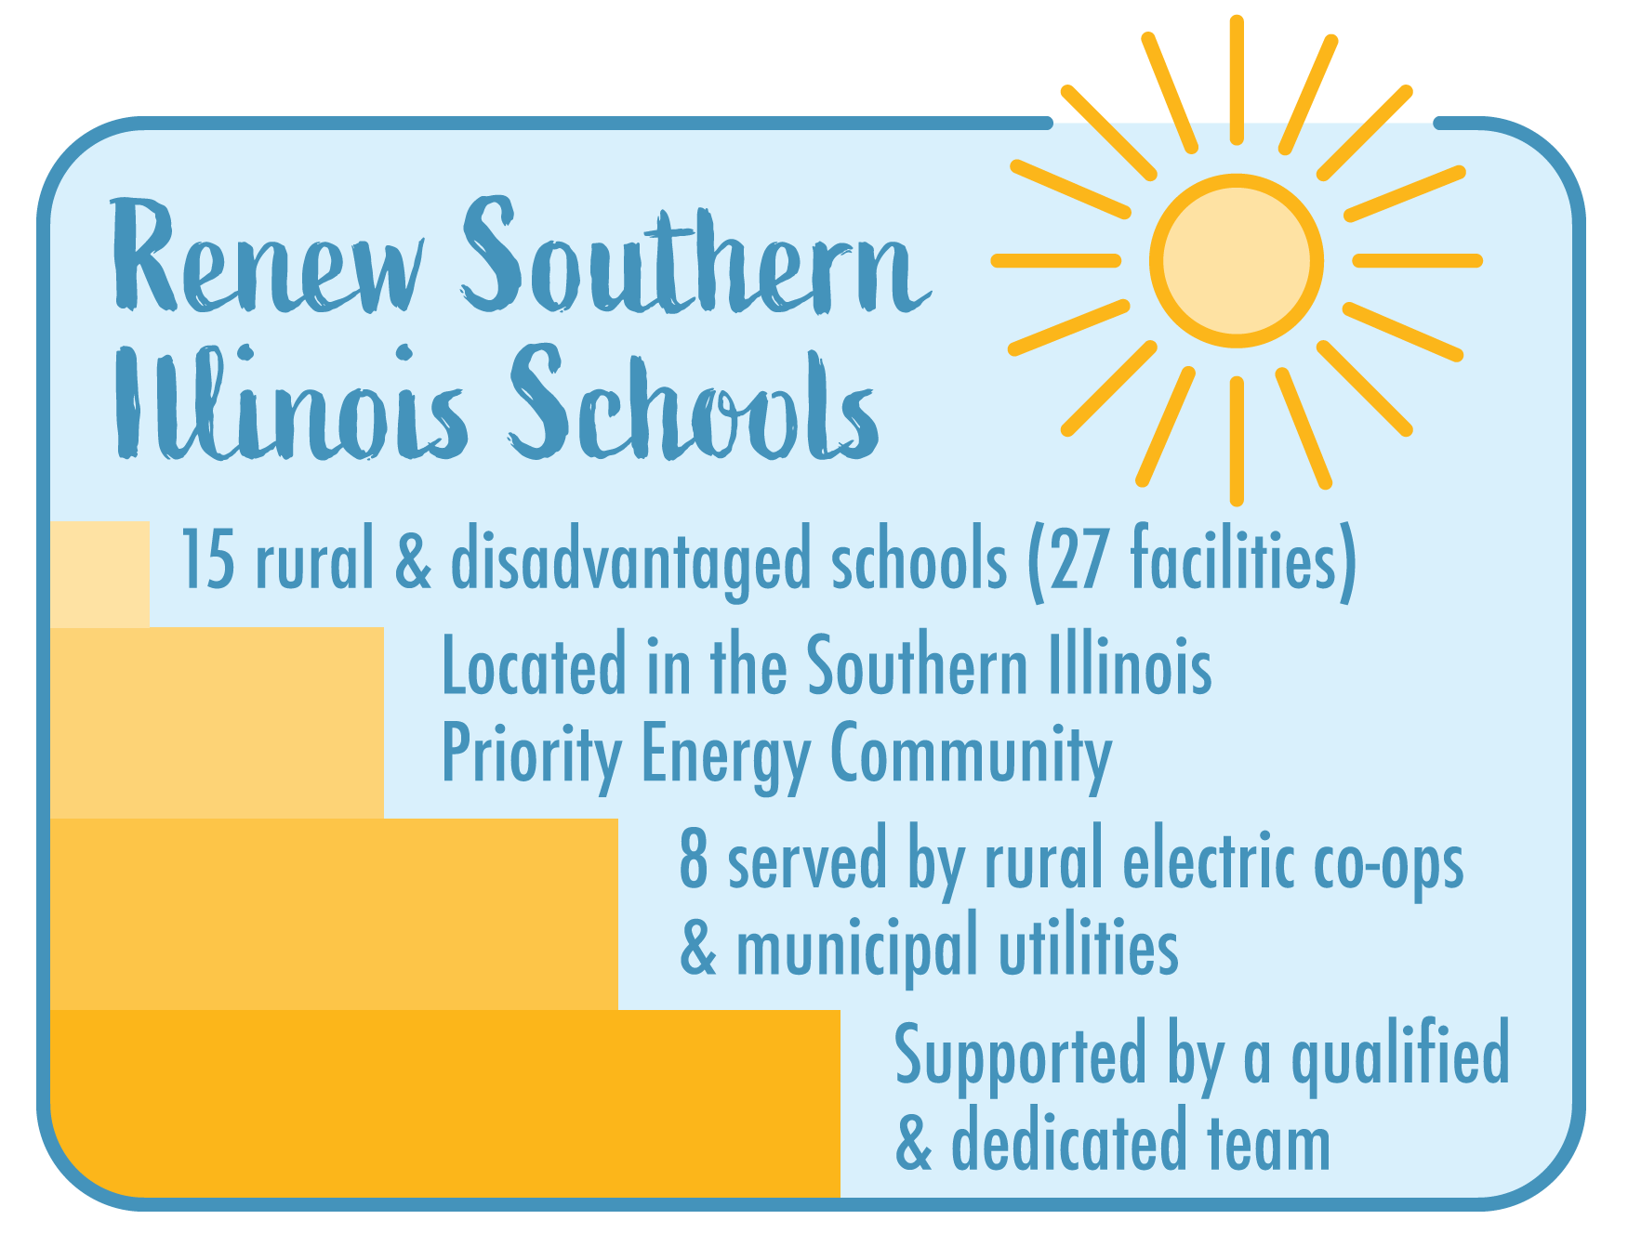
2024 Renew America's Schools Prize
Coal to Solar in Southern Illinois’ Rural Schools
  Project Description
  Our portfolio of schools are located in rural and coal producing areas of Southern Illinois, and over half are served by Rural Electric Cooperatives and Municipal Utilities. These publicly owned utilities are not subject to Illinois’ renewable energy and energy efficiency goals. Our Project Team is made up of County of Johnson, Prairie Rivers Network, University of Illinois’ Smart Energy Design Assistance Center, Climate Jobs Illinois, Illinois Finance Authority/Illinois Climate Bank, Faith in Place, and Egyptian Electric Cooperative Association. We plan to conduct energy audits, energy planning, and energy upgrades and implement our community benefits plan.
  Summary of Need (Community, Facility)
Southern Illinois has been grappling with significant economic challenges, exacerbated by the decline of the coal industry, which has historically been a cornerstone of the region's economy. All of our school districts are located in the Southern Illinois Priority Area Energy Community as identified by the Interagency Working Group on Coal and Power Plant Communities. Our schools are located in rural and disadvantaged areas. Specifically, 12 of our 15 school districts are rural and 12 of our 15 school districts serve disadvantaged areas. The schools have high percentages of students qualifying for free and reduced priced lunch. The school facilities are in need of energy upgrades and ready to become more resilient with renewable energy.
  Project Goals
Our Goals are to reduce energy consumption and costs, promote renewable energy adoption, and to improve the health and safety of our schools in rural and coal producing areas of Southern Illinois.

