Slide 1
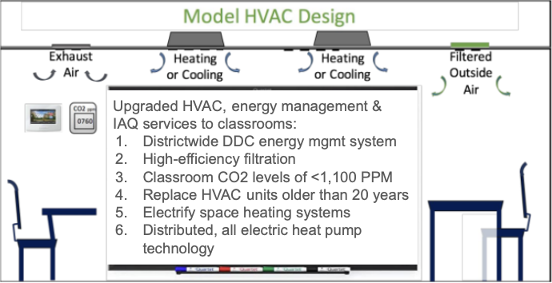
Team Student Voices
2024 Renew America's Schools Prize
Building Intentional Change
  Project Description: Modesto City Schools (MCS) & Climate Action Pathways for Schools propose a high-impact energy efficiency, health, & youth apprenticeship project to:
Achieve the zero emissions standard as defined by the DOE, including energy efficient school buildings, free of onsite emissions from energy use and powered solely from clean energy
Safeguard student & staff health through energy & infrastructure upgrades
Offer paid Youth Apprenticeships in Sustainability Professions
  Summary of Need: Modesto is rich in diversity but disproportionately impacted by the adverse effects of climate change, compounded by economic challenges. 80-99% of students in portfolio schools are eligible for free & reduced-price lunch.
  Project Goals: Implement energy efficiency improvements across 19 MCS facilities to:
Reduce energy usage intensity (EUI) from 37.3 to 24.0 & energy usage by 36%, saving $800K in operating costs
Improve indoor environment to safeguard community health
Engage youth in sustainability-focused apprenticeships, providing valuable career experience for in-demand jobs

