Slide 1
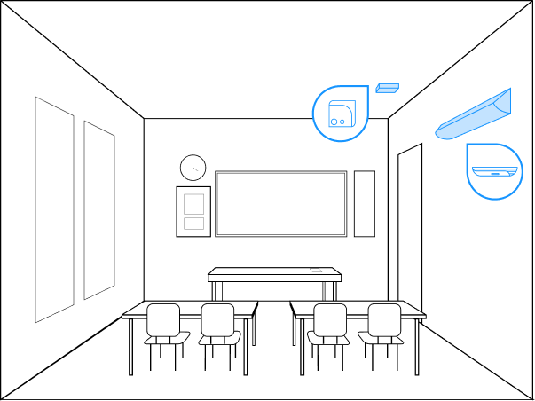
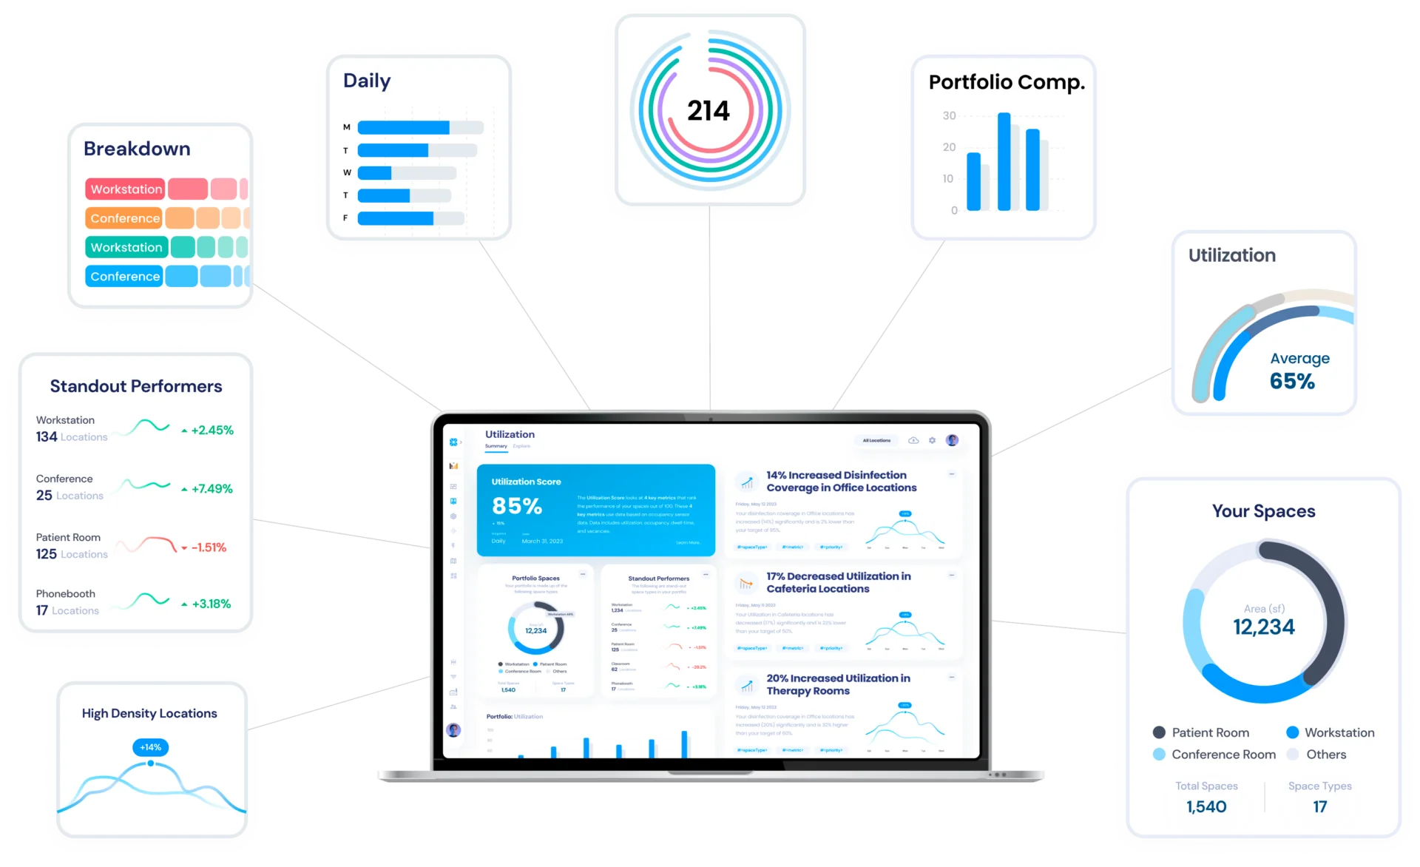
The Academy Charter School
2024 Renew America's Schools Prize
TACS-Life and Energy Saving Initiative
  Project Description
  Academy Charter is composed of 11 schools offering equitable educational opportunities from kindergarten through grade 12. Since its inception in 2009, it has expanded to serve 7,015 students across eleven schools in the districts of Hempstead, Uniondale, and Wyandanch. Academy Charter is proposing 5 projects: (1) Upper-Room Ultraviolet Germicidal Irradiation (UR-UVGI) for energy efficient air disinfection, (2) Advanced Filtration for energy efficient air cleaning, (3) Far-UV Technology for energy efficient, real-time air and surface disinfection, (4) Occupancy Demand Controlled Ventilation for HVAC energy optimization, and (5) LED light infrastructure upgrade.
  Summary of Need (Community, Facility)
  Since the pandemic, our HVAC systems are consuming significantly more energy, and we need solutions that deliver the best possible air quality while still being energy efficient. Additionally, our older facilities still use fluorescent lighting, which is not only more energy intensive, but produces lower quality lighting. These buildings serve many students from disadvantaged communities, and reaching environmental equality for all is a key priority for us. 89% of students aged 5 to 17 from our Hempstead school district live in poverty and 65% receive assistance under Title IV of the Social Security Act. In Uniondale, 65% of students aged 5 to 17 live in poverty and 49% receive assistance under Title IV.
  Project Goals
  The goal of these projects is to reduce energy consumption while improving the indoor air quality in the school facilities. This will not only enhance our sustainability footprint and create energy savings that can be used to fund school programs, but also ensure that we are providing the healthiest learning environment possible for our students and staff.
  Illustrative smart classroom with UR-UVGI air disinfection and a connected sensors platform informing building systems software

