Slide 1
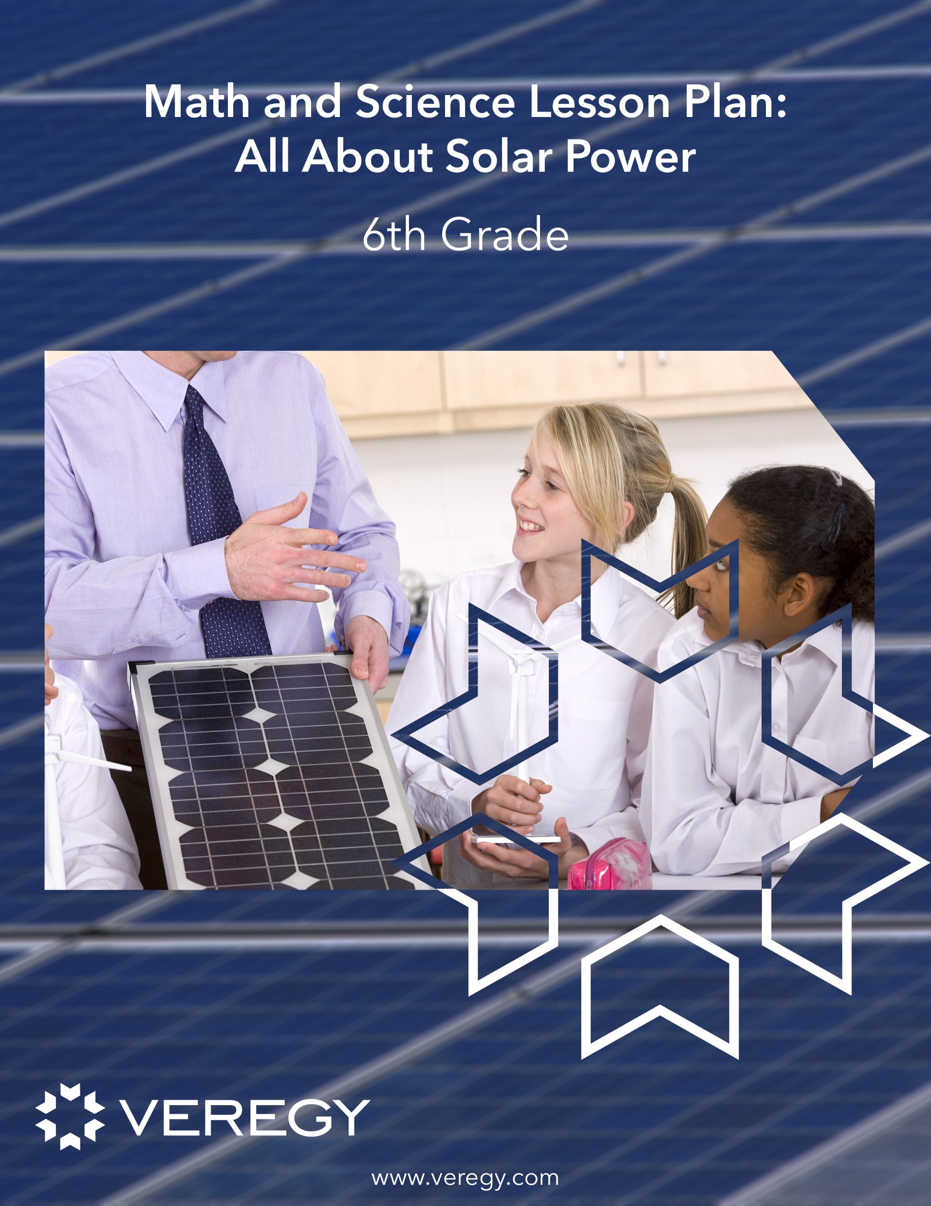
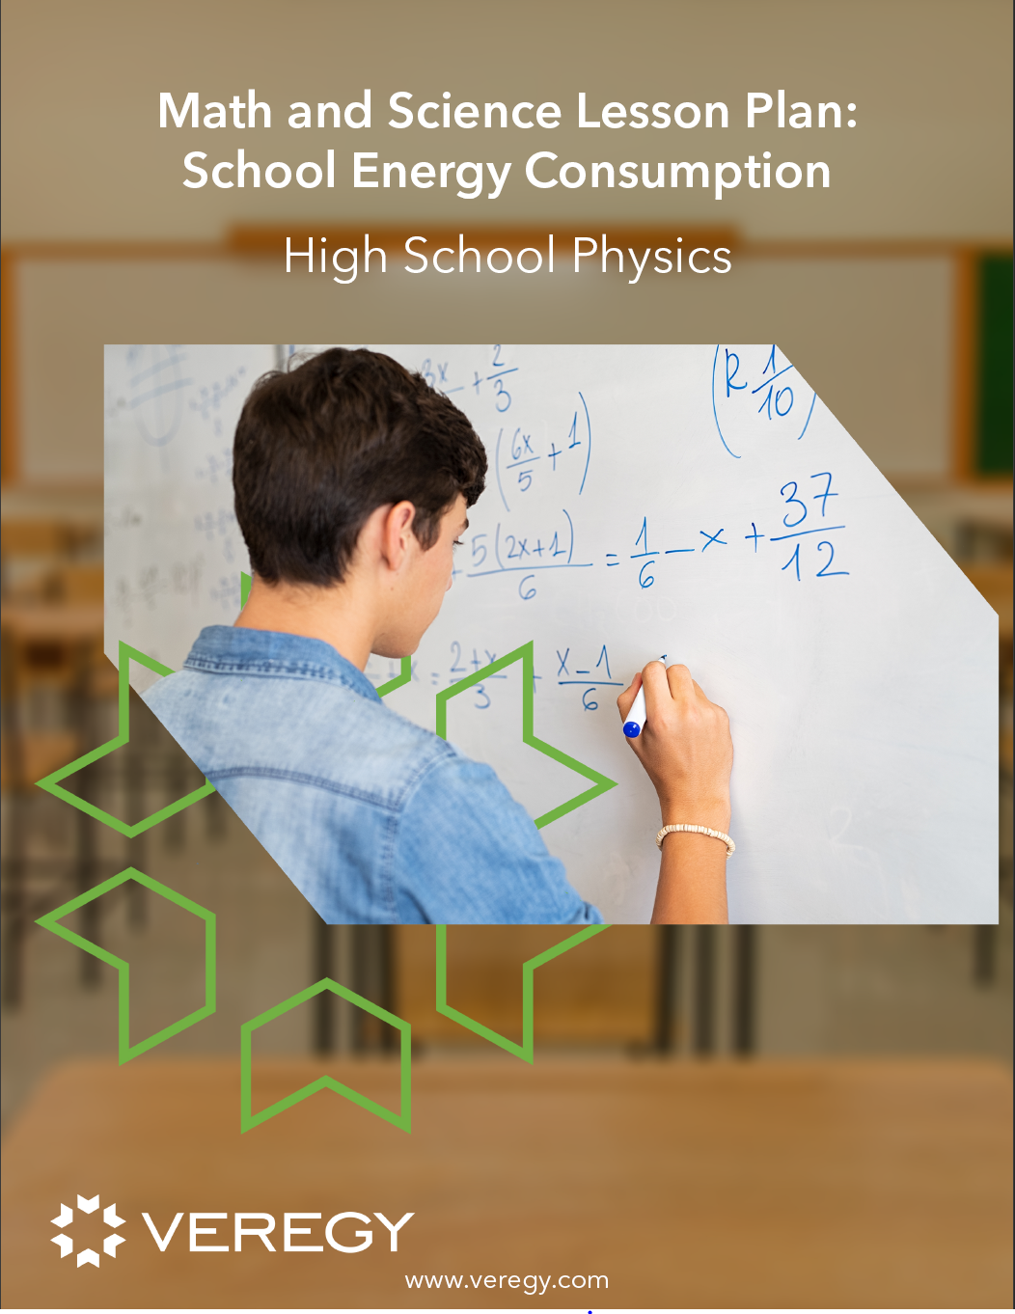
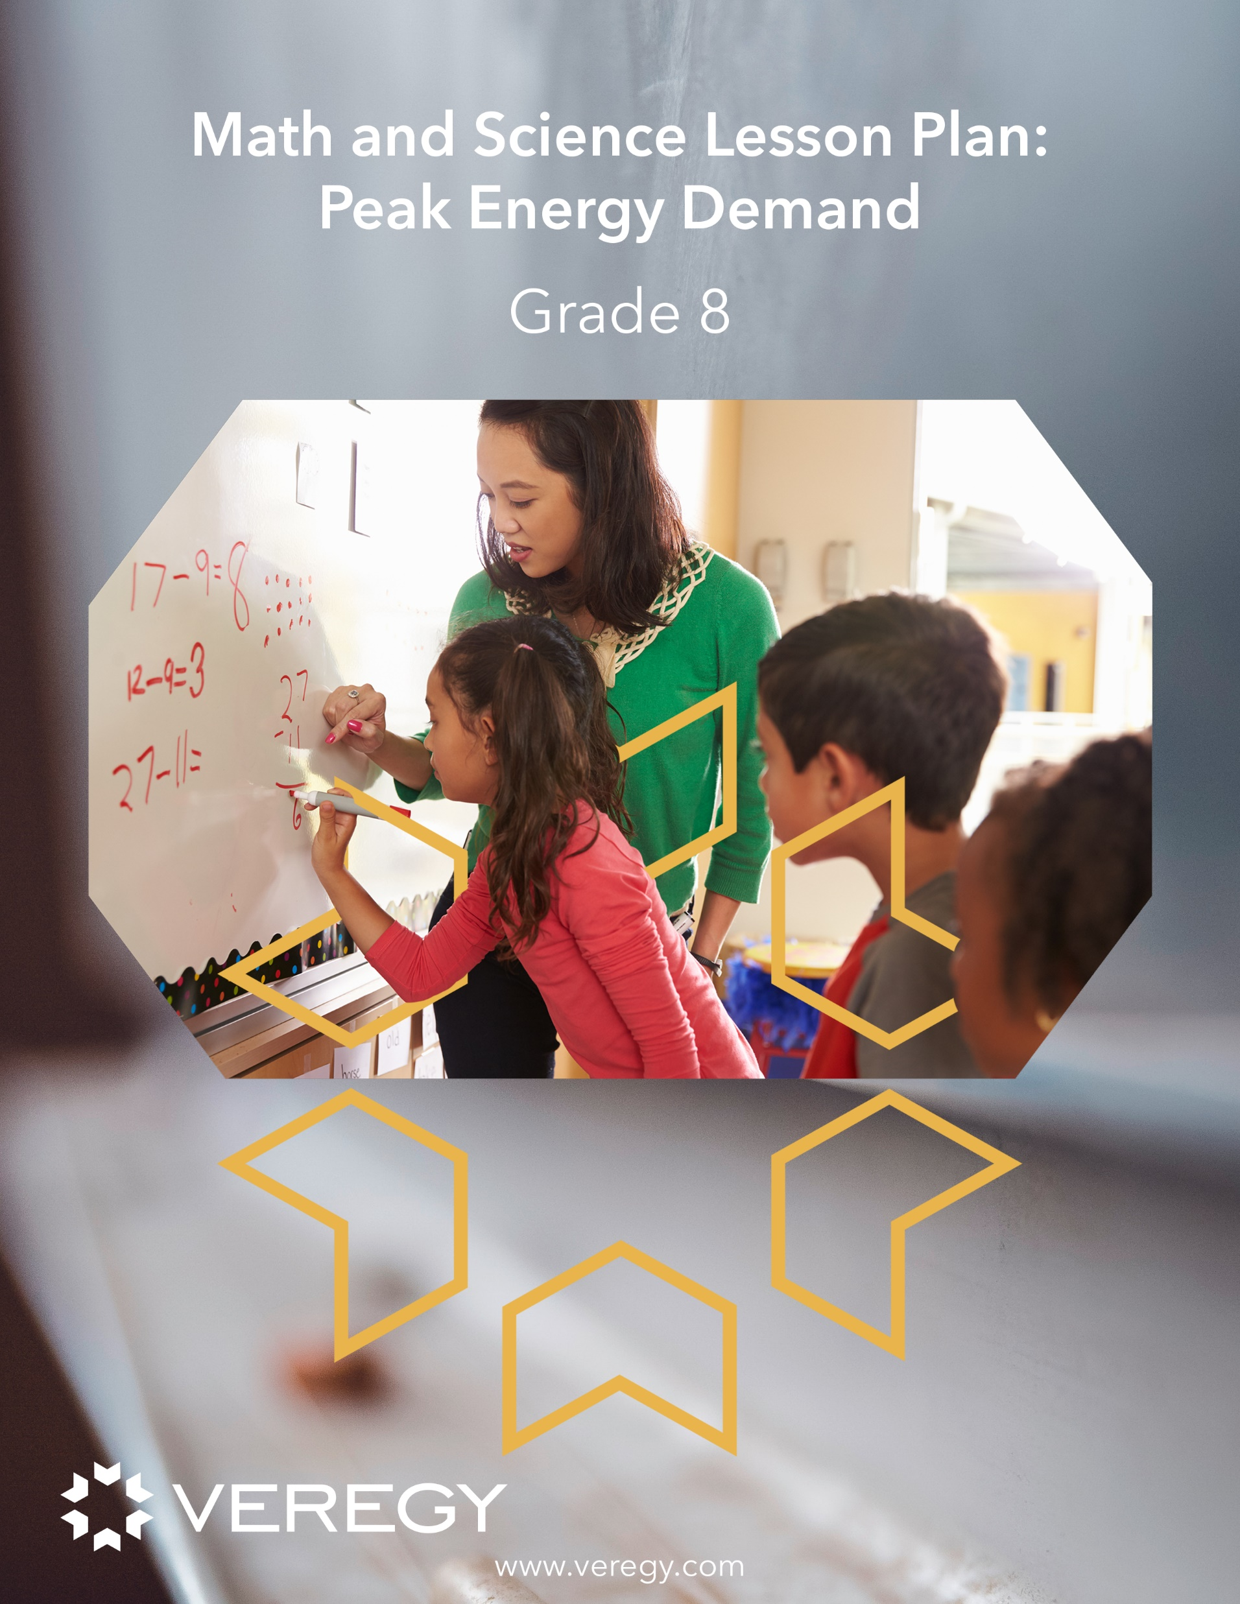

Peoria Illinois Public Schools
2024 Renew America's Schools Prize
High-Impact Energy Efficiency and Healthy Building Improvements
  Project Description
  Utilizing the Peoria Administration Team, Board of Education, and expertise of VEREGY (A Leading Provider of Engineering and Energy Efficiency Optimizations), we intend to implement a combination of improvements in a total of sixteen (16) district schools: Heating, Ventilating, Air Conditioning (HVAC), Windows, Roofing, Lighting, Electrical & Switchgear Upgrades, with the addition Solar Photovoltaic (PV technology).
  Summary of Need
  Peoria Public Schools (PPS) has been identified as a Disadvantaged Community, serving nearly 13,000 students and 2,700 staff members with 30 total buildings. We have identified 16 of these buildings that are older with aging/failing systems that are operating beyond typical lifespan. Funds are limited within the district to address all of the current infrastructure needs. The Renew America Grant funding will allow the district to improve over half of the existing facilities so that Peoria can continue to provide the best educational opportunities for their students and necessary community programs available through the district facilities.
  Project Goals
  Reduce Long-term Energy and Operational Costs
  Create Safe, Comfortable, and Productive Learning Environment for Staff and Students
  Reduce Carbon Footprint
  Utilize Project as “Live Learning Lab” for student education.
  Create Internship Opportunities for Students and Jobs for Community Workforce

