Slide 1
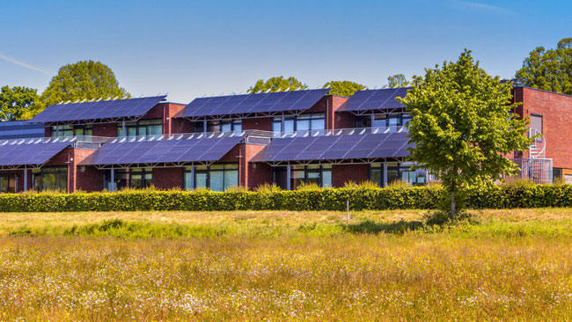
Vermilion County Schools Cooperative
2024 Renew America's Schools Prize
Clean Energy & Air Illuminate Vermilion Schools!
  Project Description
  "Illuminate Futures: Vermilion County Rural Schools Cooperative (Georgetown-Ridge Farm CUSD 4, Westville SD #2, Potomac CUSD #10, Hoopeston Area Schools #11) lead with solar energy, UV-C air systems, LED lighting for clean, healthier, sustainable learning!"
  Summary of Need
  The schools across Georgetown-Ridge Farm CUD #4, Westville SD #2, Potomac CUSD #10, and Hoopeston Area SD #11 exhibit a high need for energy assessments and improvements due to their age, deferred maintenance, fiscal constraints, high energy costs, and failing systems. These challenges underscore the critical need for modern energy solutions, such as solar power installations and innovative HVAC controls, to enhance energy efficiency, reduce operational costs, and improve the learning environment for students. The proposed energy improvements and air quality systems will address these needs, ensuring sustainable and resilient school facilities.
  Project Goals
  Modernizing school facilities with advanced solar and air systems enhances learning environments and STEM education, reallocates savings to resources, improves air quality and health, and ensures emergency resilience. This project promotes equity, economic stability, and community ties, fostering overall student growth.
Insert Key Graphics (illustrations, charts, and/or tables)

