Slide 1




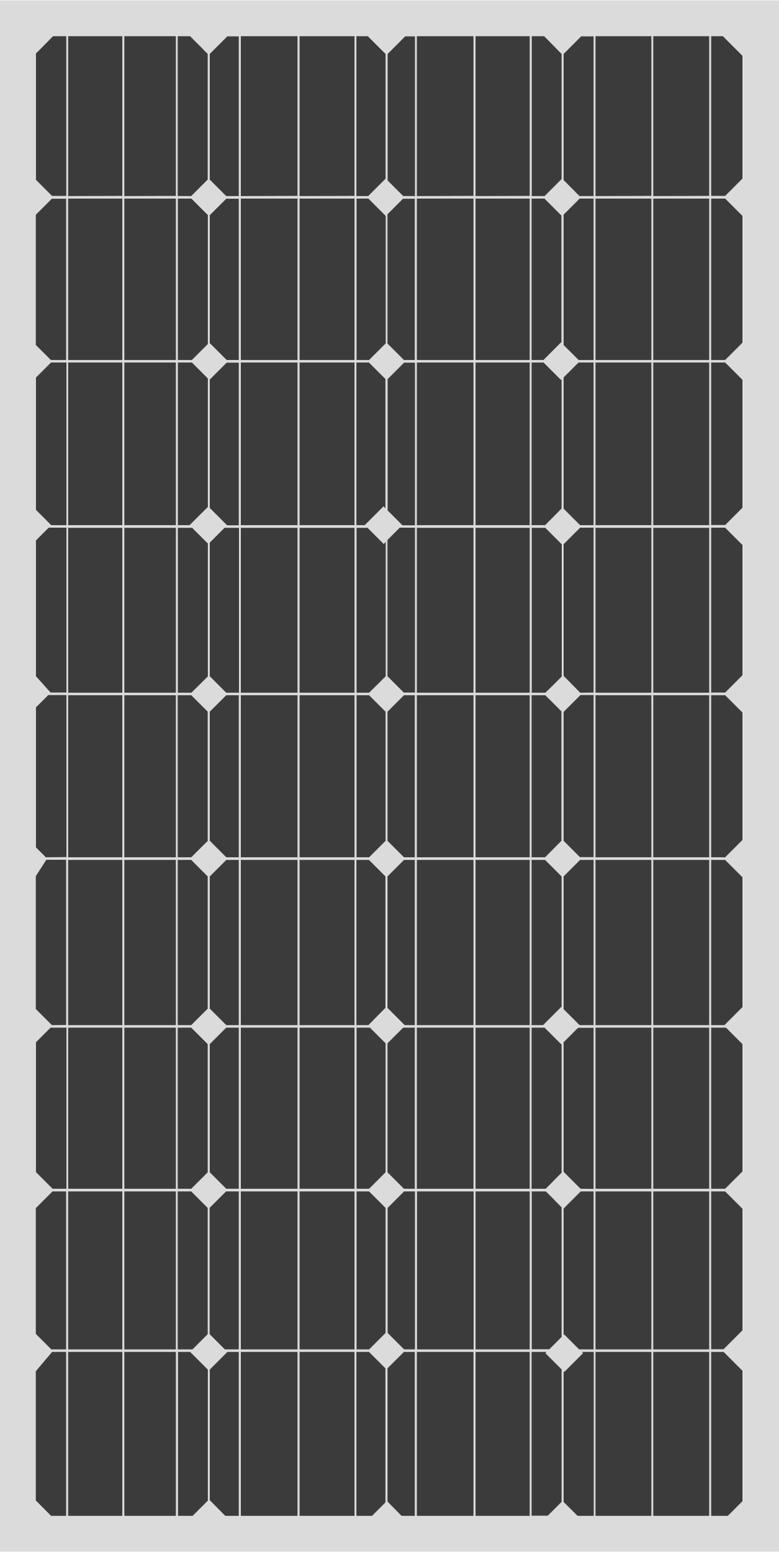


RenewaBULL Power Team
PROJECT DESCRIPTION
ANTICIPATED COMMUNITY BENEFITS
DPS, a school district with 55 schools located in central North Carolina, envisions a clean energy future where we teach and model the importance of pursing opportunities not only to reduce greenhouse gas emissions and lower energy cost burdens, but to also create healthier spaces for students, and boost pathways for students and young professionals to enter and create jobs in the clean energy sector.
  20 DAC schools will receive energy efficiency and renewable energy improvements
    All elementary schools are Title I
    2 schools are FEMA disaster response shelters
    8 offer before/after care
    4 have preschools
  Increased resilience in disadvantaged communities
  Good neighbor and community benefits agreements
PROJECT GOALS
The four primary goals for the project are:
PROPOSED BUDGET
DOE Funds - $15.3M
DPS Cost Share - $4.65M
Total Budget - $19.95M
KEY TEAM MEMBERS
Goal 1: Improve Indoor Air Quality
Goal 2: Reduce Carbon Emissions
Goal 3: Lesson Energy Cost Burden
Goal 4: Bolster Skilled Trades & Career Development Pathways
  North Carolina Clean Energy Fund
  SitelogIQ, Inc
  LeChase Inc
  Advanced Energy
  Willdan Energy Co
Durham
Durham Public Schools (DPS) - NCES District ID: 3701260

