Slide 1
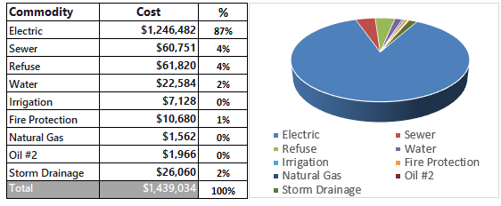
OCPS Sustainability 2030
2024 Renew America's Schools Prize
De-energizing the OCPS Community
  Project Description
  Orange County Public Schools, Hanson, & CMI will create an energy transition plan to become a scalable model for future OCPS projects. The ten schools selected are Title I from economically disadvantaged communities.
  Summary of Need (Community, Facility)
Over 12 consecutive months, 10 schools’ gross total emissions were 3,311 metric tons of CO2-equivalent (MTCO2E) with electric consumption of 6,368,862 kWh.
Support of these 10 schools is not just about education—it's about fostering well-being, breaking cycles of poverty, and building stronger communities. Championing community schools is a powerful strategy for addressing educational and neighborhood challenges.
  Project Goals
  To develop a roadmap to reduce energy consumption, through LED lighting, solar canopies, and efficient HVAC to improve building performance. In turn, will reduce carbon emissions, improve student and staff health, and provide an exceptional space for student learning.

