Slide 1







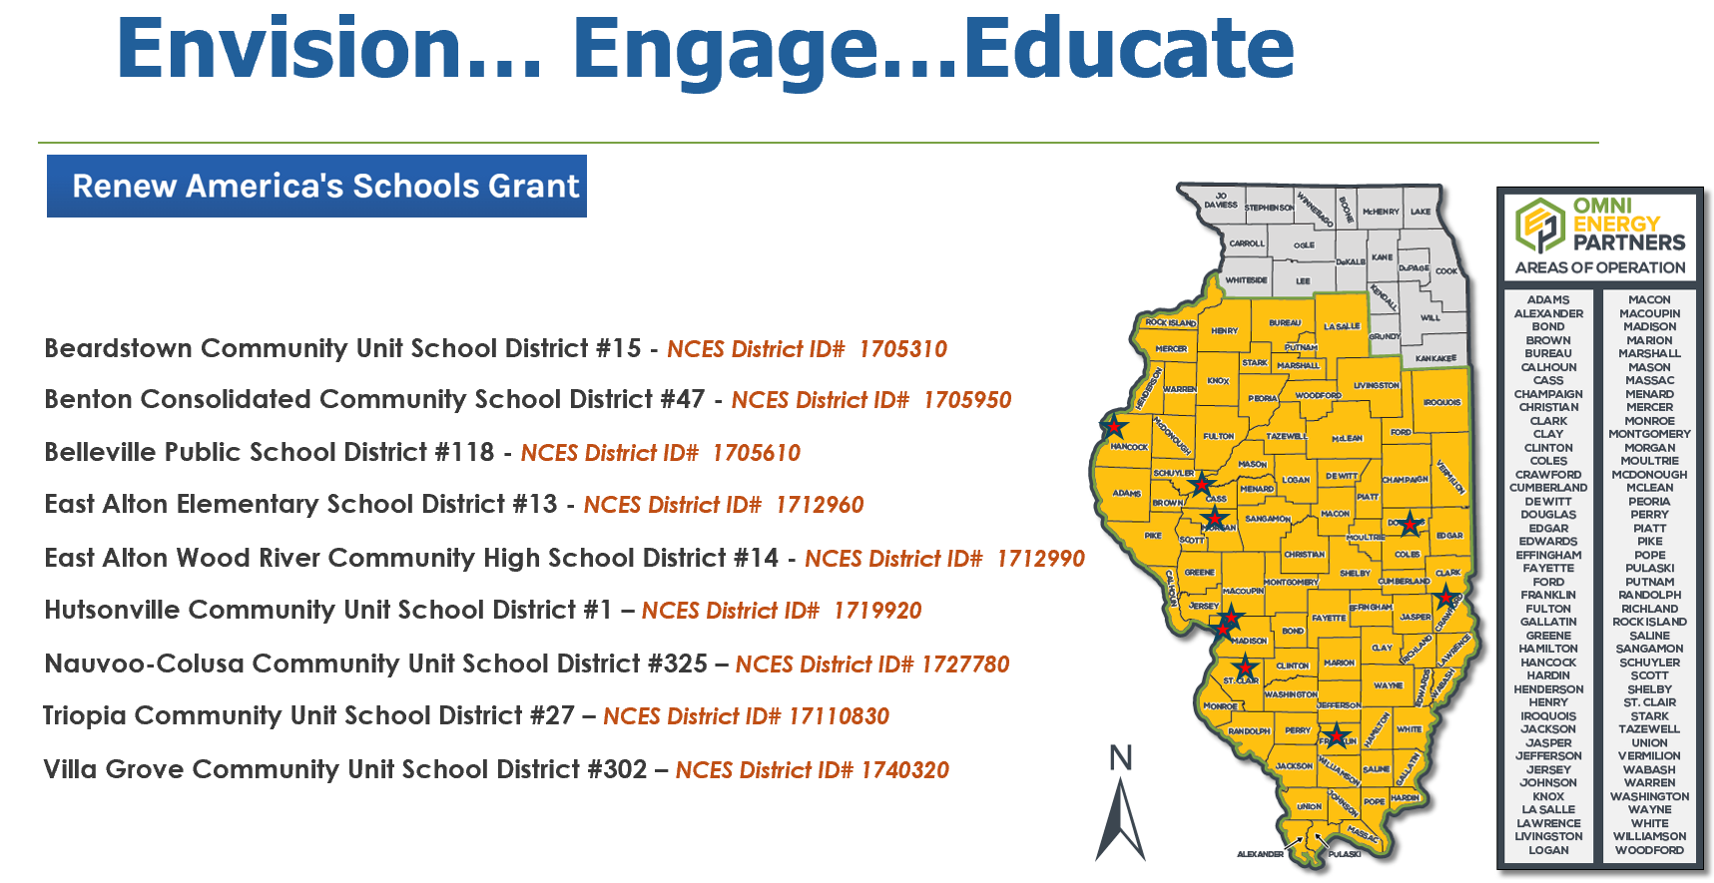
E4E:Energy 4 Education–Omni Energy Partners
2024 Renew America's Schools Prize
  Project Goals
  Implement Initial Phase Facility Improvements Summer 2025.
  “Cost Share” to exceed 50% in Stage 3
  Integrate sustainable practices & technologies in school renovations
  Work with Midwest Region of LiUNA to ensure union workforce is engaged on each project
  Extend Awareness of Environmental Initiatives through Mitsubishi Video Case Studies and partnerships with Illinois Community Colleges
E4E Energy 4 Education
  Project Description
  As Design/Build Performance Contractor we have selectively chosen nine (9) school districts with twenty (20) LEAs across the lower half of Illinois within our portfolio submission for consideration by the Department of Energy.
  Summary of Need (Community, Facility)
  Most of the districts incorporated into this initiative are identified as Disadvantaged Communities. By incorporating elements of the Justice40 initiative into the E4E TEAM, we will work with Midwest Region of LiUNA to leverage these improvements to not only enhance local infrastructure but to also address environmental justice and economic equity at the local and regional level which has been very difficult for rural communities in down-state Illinois to accomplish.

