Slide 1

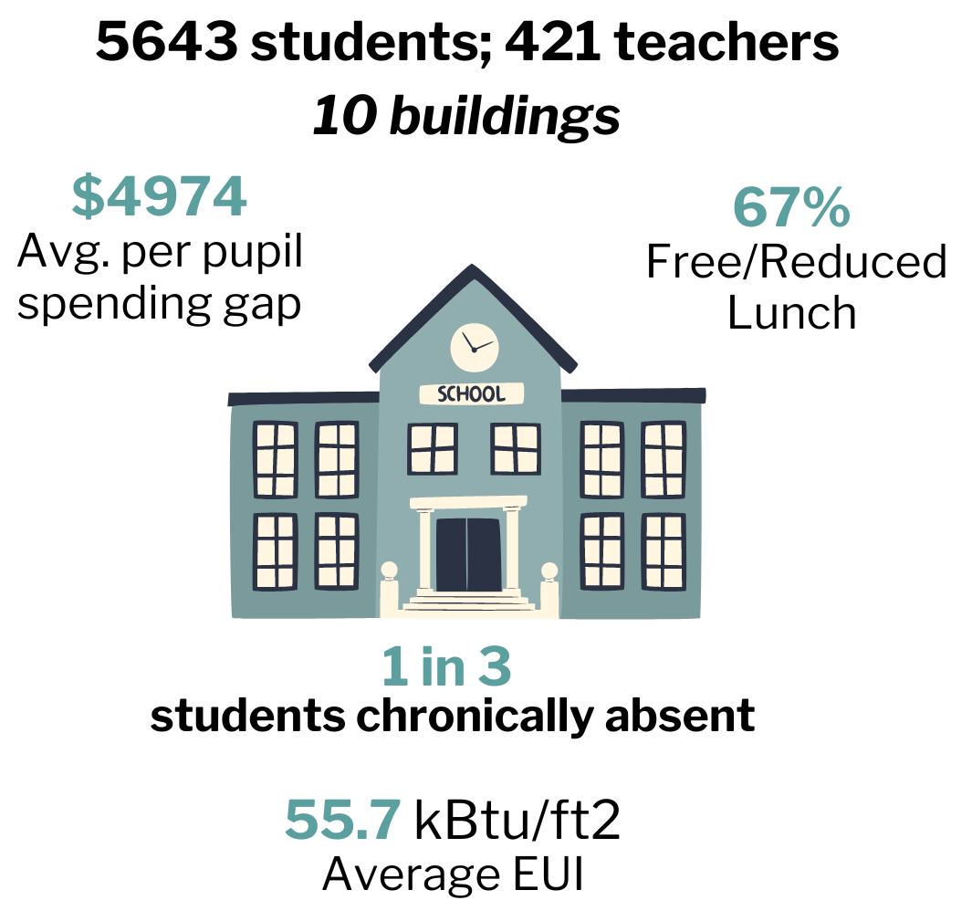
Team
Renew Pennsylvania Schools – Montgomery ASD and Williamsport ASD
2024 Renew America's Schools Prize
  Project Description
  Renew Pennsylvania Schools includes eight schools and two district facilities in need of energy and air quality improvements to combat rising energy costs and chronic absenteeism nearly double the national average. All schools in our portfolio are Title 1 schools in DOE designated Disadvantaged Communities.
  Summary of Need (Community, Facility)
  Children in our two Lycoming Co. districts (locale codes 13, 31, and 41) face significant challenges, and are forced to learn in school facilities that are in poor condition and have aging, inefficient systems (avg. age of HVAC systems=21 yrs.). In PA, where our education funding mechanism was found unconstitutional in 2023, federal and private investment in the energy efficiency/savings and air quality of our facilities is needed.
  Project Goals
  Improving air quality and energy savings to:
  Reduce chronic absenteeism
  Shift energy savings to student learning support

