Slide 1

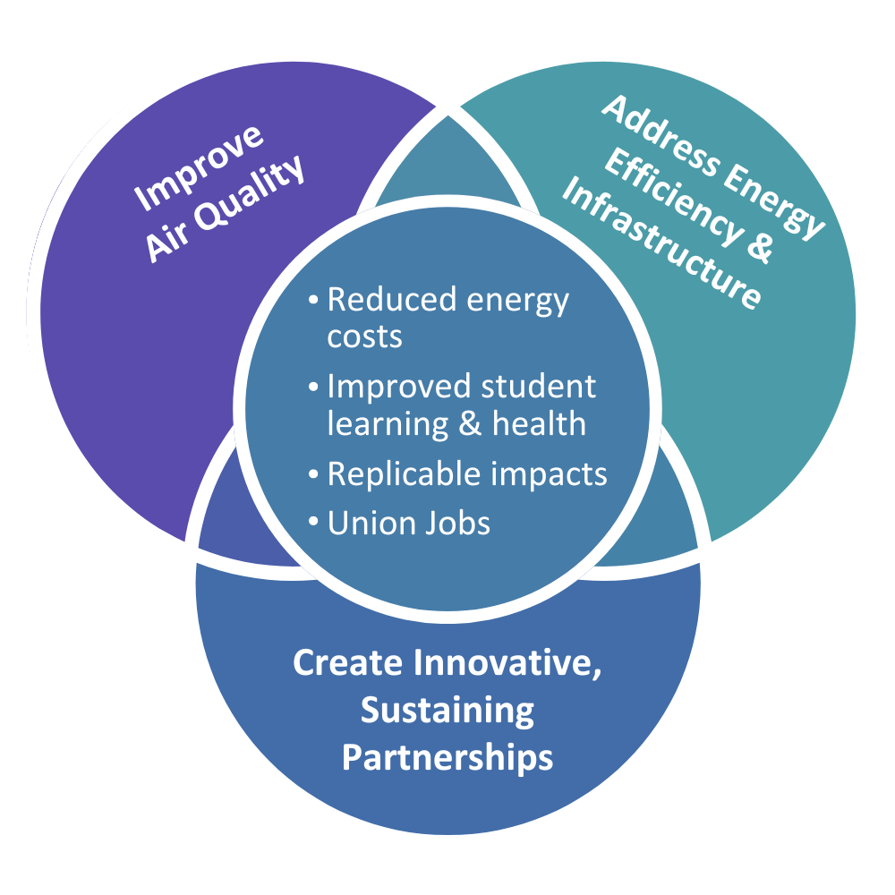
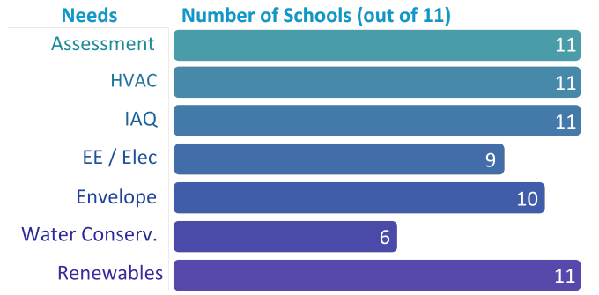
ODE Oregon Disadvantaged Communities
Upgrading Oregon’s Disadvantaged Community Schools
2024 Renew America's Schools Prize
  Project Description: Collaborating statewide, the Oregon Department of Education, SMART Local 16, Oregon State Association of Electrical Workers (OSAEW), Community System Solutions (CSS), and 11 schools across various districts—including Three Rivers/Josephine County, John Day/Grant, Tillamook, Winston-Dillard, Jefferson County, Douglas County/Roseburg, and South Umpqua—are joining forces to retrofit schools in Disadvantaged Communities. Their objective: to improve indoor air quality, energy efficiency, and infrastructure while simultaneously cutting costs.
  Summary of Need of Schools
  Project Goals
Enhance IAQ, health, and learning
Improve energy efficiency and renewables
Modernize outdated infrastructure
Reduce operational and maintenance costs
Grant funding is urgently needed to modernize infrastructure in Oregon schools serving economically disadvantaged and diverse communities, ensuring safe, energy-efficient learning spaces for students facing economic challenges.

