Slide 1



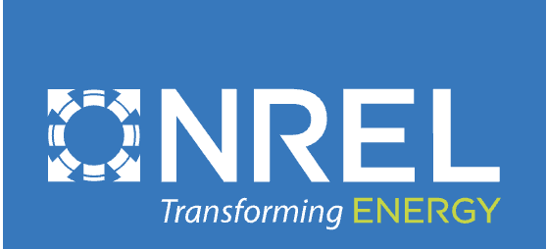

Interior Alaska Renew America’s Schools Consortium
Project Description: The IARASC intends to reduce carbon emissions and operating costs in 15 rural Alaskan public school facilities by working with statewide technical partners to establish strategic plans that address failing, inefficient facility components. The IARASC intends to be energy efficiency champions in the Alaskan education community.
Project Need:
All 11 communities addressed are rural remote and considered disadvantaged
6/11 communities experience above-average Alaskan poverty rates ranging between 12.5-37.2%
6/11 communities experience child poverty rates ranging between 15-65%
8/11 schools addressed offer all students free lunch
Facilities are heated and powered close to 100% by fossil fuels, primarily heating oil and coal.
Conservative estimates of the Consortium put potential carbon emissions reduction at 2,095.5 tons per year if Phase 3 goal is successfully achieved.
Conservative estimates of the Consortium put potential combined energy cost savings to participating districts at $207,570.27 per year if Phase 3 goal is successfully achieved.
Phase 2 Project Goals:
Establish Partner MOUs & Procedures (11/24-12/24)
Site Energy Audits and Benchmarking (11/24-05/25)
Energy Efficiency Strategic Plans & Community Engagement (11/24-09/25)
Phase 3 Project Goal:
Reduce collective site emissions & operating costs by a minimum of 20% through addressing HVAC systems, building envelopes, on-site renewable power generation, and lighting/electrical systems as determined in partnership with technical vendors and community stakeholders.

