Slide 1

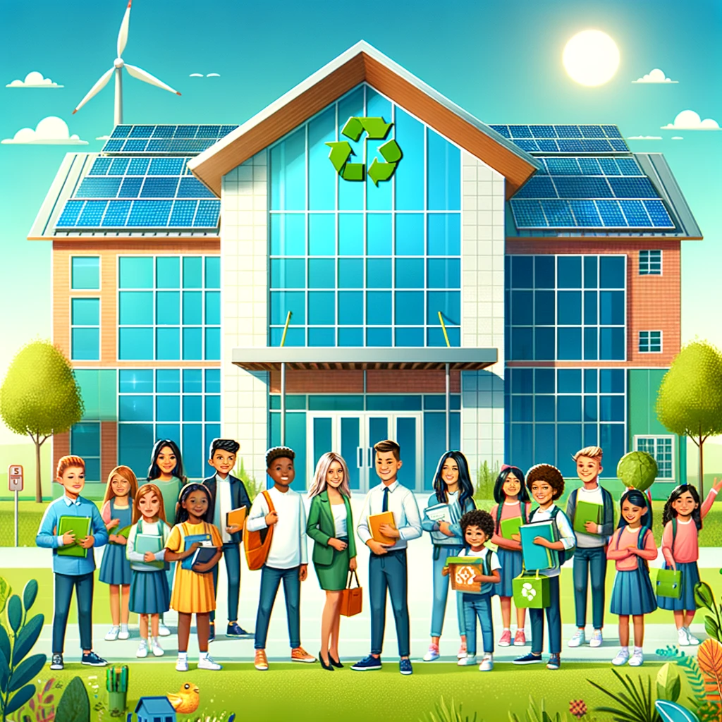
Greener Schools, Brighter Futures: Maximizing Carbon Reduction for Underserved Students with DC Public Schools' First ESPC
2024 Renew America's Schools Prize
Project Description
  Project Goals
Portfolio of Schools Identified. The District Department of General Services (DGS) proposes to target 17 Title 1 schools in disadvantaged areas of Washington, D.C., serving predominantly students of color and low-income students. These schools, facing high energy costs and aging infrastructure, urgently need energy efficiency improvements to create safer and healthier learning environments.
Project Team. DGS’ project team comprises DLR Group, NV5, and key community partners like Teamsters Local 639 and the FH Faunteroy Community Enrichment Center. This experienced team will ensure successful project implementation through technical expertise, workforce development, and community engagement.
Proposed Plan. DGS’ plan aims to implement energy efficiency measures and transition to cleaner electric systems in the 17 schools, leveraging the ESPC and RAS Grant. Goals include reducing energy consumption and greenhouse gas emissions, improving indoor air quality, and providing workforce training opportunities to promote long-term economic stability.
Improve Learning Environments: Enhance indoor air quality and reduce respiratory illnesses, benefiting student health and attendance.
Energy and Emissions Reduction: Electrify heating and cooling systems to lower energy use and greenhouse gas emissions.
Workforce Development: Create training programs for local workers, providing valuable skills and job opportunities.
Economic and Community Benefits: Lower operational costs, freeing up resources for educational programs and community services.
Empowering Students with Sustainable and Energy-Efficient Schools for a Brighter Future
Summary of Need (Community, Facility)
The 17 targeted schools in Washington, D.C., serve predominantly students of color and low-income families. They face significant challenges from aging infrastructure, deferred maintenance, and high energy costs. These conditions negatively impact student health, attendance, and academic performance. This funding opportunity is crucial to implementing energy efficiency measures, reducing operational costs, improving indoor air quality, and creating healthier, safer learning environments, addressing both educational and community needs.

