Slide 1
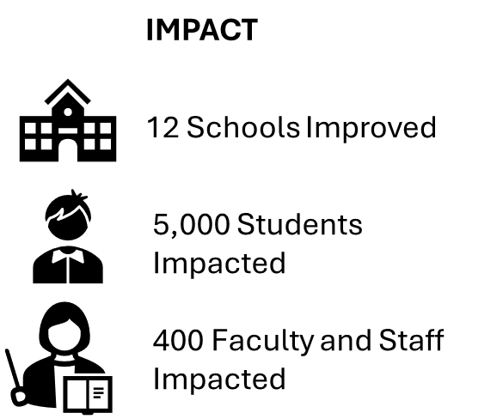
Ferguson Reorganized
2024 Renew America's Schools Prize
Submission or Entry Title
  Project Description
  Ferguson Florissant School District R-II (Ferguson Reorganized) will work with an energy performance contracting partner to improve HVAC systems and building envelope, working toward a larger, long term sustainability initiative.
  Summary of Need (Community, Facility)
  Our district has assessed needs for all buildings in our jurisdiction, but is unable to generate the capital required to begin our long term energy savings project. Our district is nearly 100% free and reduced lunch participation, and is located within a historically disadvantaged and underserved community, both economically and environmentally
  Project Goals
  #1: Improve Indoor Air Quality and Comfort
  #2: Reduce Energy Consumption and Operational Costs
  #3: Support Workforce Development and Community Engagement
  #4: Ensure Project Sustainability and Resilience

