Slide 1
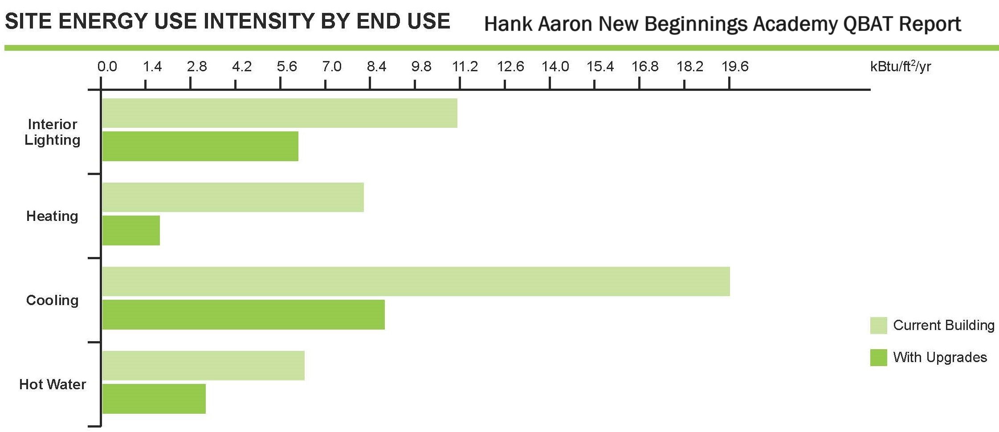
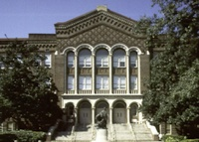
Team APS – Atlanta Public Schools
2024 Renew America's Schools Prize
Renew Atlanta Public Schools
Renew Atlanta Public Schools will provide Safe and Healthy Learning Environments for 9,798 students and 786 certified classroom teachers in 20 schools in disadvantaged, high-need communities (DAC) in Atlanta, GA (Locale- 11-City: Large) and are Title 1 eligible; 100% of students qualify for the federal free school meals program. Chronic absenteeism is more than double the national rate.
Summary of Need (Community, Facility)
Portfolio schools include the B.T. Washington High School,
on the National Register of Historic
Places, the first public high school
for African Americans in GA. Notable
Alumni include Lena Horne and
Martin Luther King Jr.
  Project Goals
  Improving air quality and energy savings to:
  Promoting better attendance and enhancing student performance
  Shift energy savings to student learning support
28%
anticipated annual energy savings for all schools is
Dr. Dylan Brewer, a professor at the Georgia Institute of Technology, will conduct a quasi-experimental design evaluation of the project.

