Slide 1

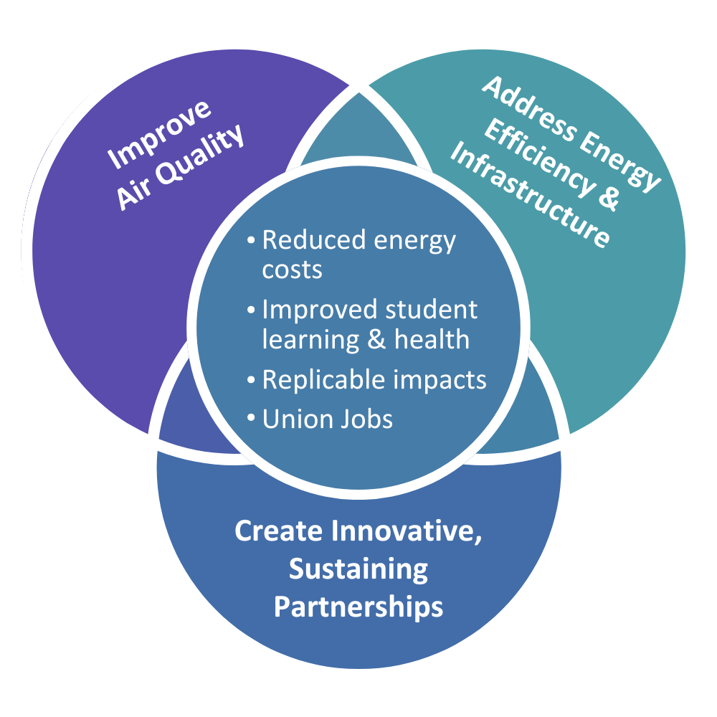
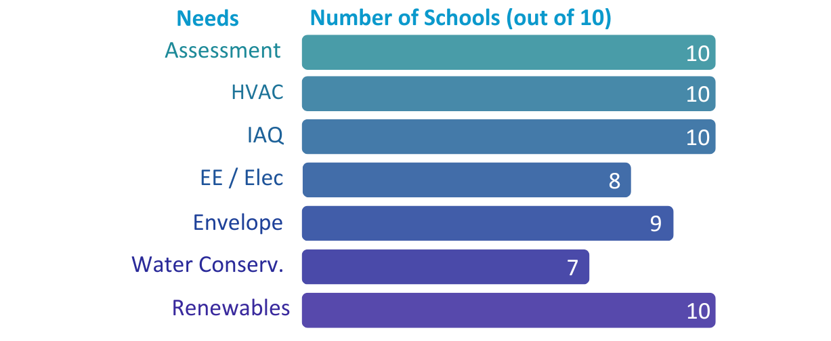
ODE Rural & Title 1 Educational Alliance
2024 Renew America's Schools Prize
Revitalizing Oregon’s Rural and Title 1 Schools
  Project Description: Collaborating statewide, the Oregon Department of Education, SMART Local 16, Oregon State Association of Electrical Workers (OSAEW), Community System Solutions (CSS), and 10 schools across various districts—including Banks, Gaston, Parkrose, Hillsboro and La Grande —are joining forces to retrofit schools in Rural & Title 1 communities. Their objective: to improve indoor air quality, energy efficiency, and infrastructure while simultaneously cutting costs.
  Project Goals
Enhance IAQ, health, and learning
Improve energy efficiency and renewables
Modernize outdated infrastructure
Reduce operational and maintenance costs
Summary of Need of Schools
Grant funding is urgently needed to modernize infrastructure in Oregon schools serving economically disadvantaged and diverse communities, ensuring safe, energy-efficient learning spaces for students facing economic challenges.

