Slide 1
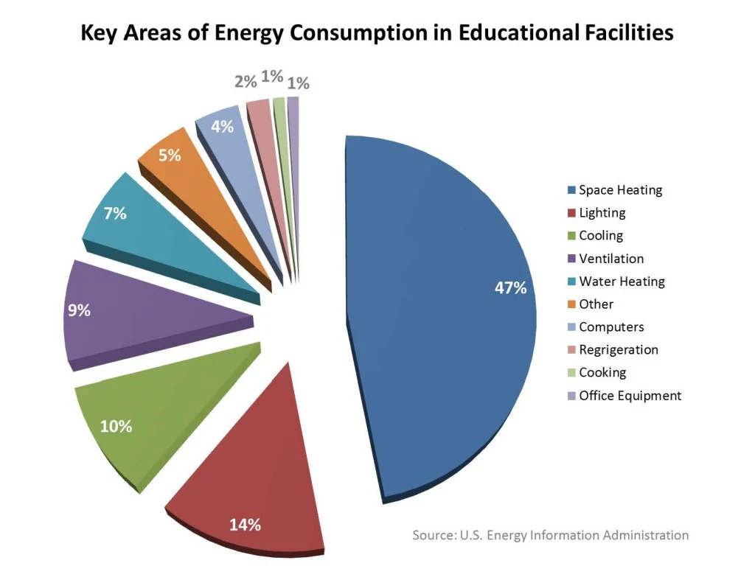
Nadya Bucklin - SRDC (MN Statewide Coalition)
2024 Renew America's Schools Prize
Minnesota Statewide Coalition for Temperature and Air Quality Regulation
  Project Description
  The project includes 16 school facilities – charters and rural public schools - across MN, as well as partnerships of other regional development commissions and state and national organizations and contractors. The project will focus on improvements to schools’ heating and cooling systems, including ventilation, to better regulate temperatures as our state experiences increased temperature swings.
  Summary of Need (Community, Facility)
  Our small rural and charter schools have limited funding and are housed in mostly old and inefficient buildings, with deteriorating HVAC, boilers, and ventilation systems. The project will benefit diverse groups; BIPOC students and community members, immigrant families, rural residents, and low-income groups.
  Project Goals
  Each school will have energy improvement recommendations and at least one energy improvement completed by the end of the project period. The community and DEIA principles will be included at each stage of the project.
Insert Key Graphics (illustrations, charts, and/or tables)

